Slide 1

Coniston Coppermines
Part 5
Stephe Cove October 2026
CATMHS exploration
Stay out, stay alive
In memory

Slide 2
CATMHS EXPLORATION

Slide 3
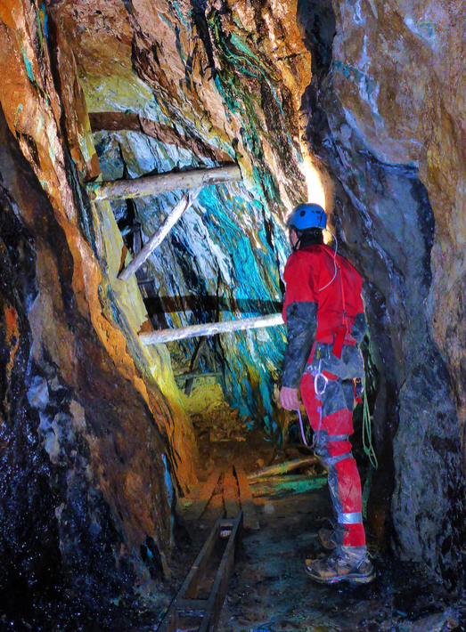
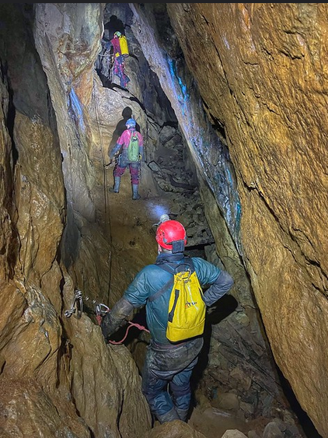
Exploration

Slide 4
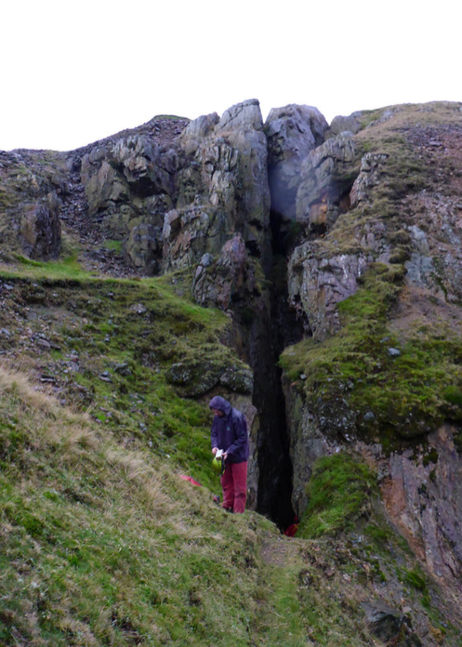
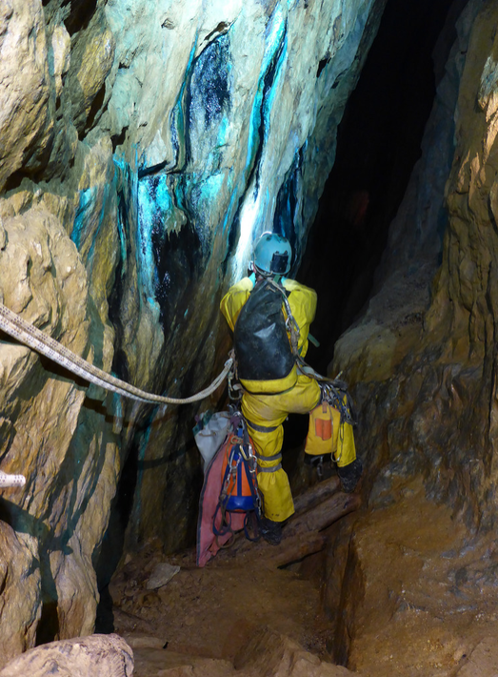
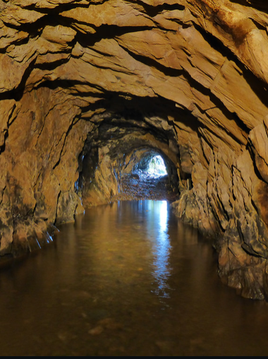
Through trip from Levers Water, down 160 metres before back into daylight

Slide 5
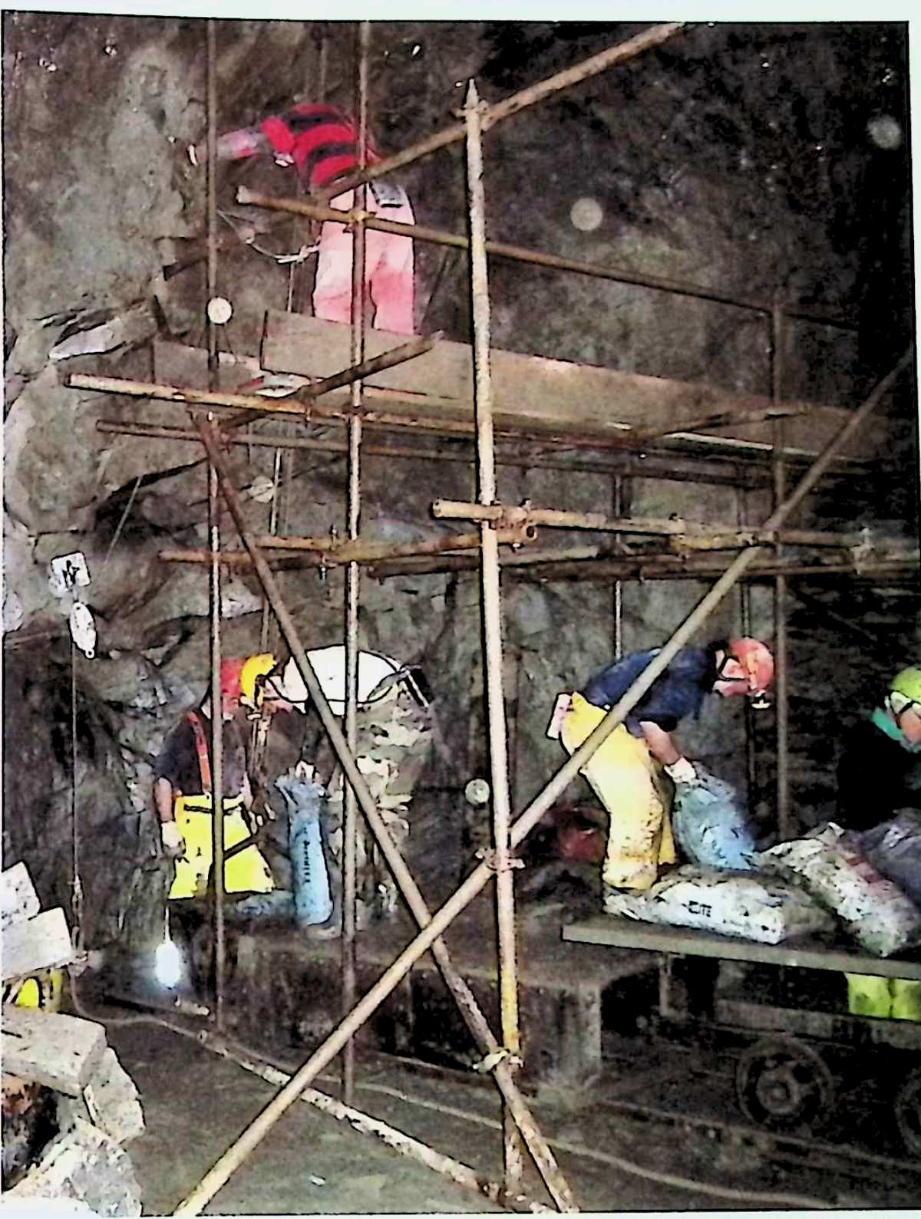
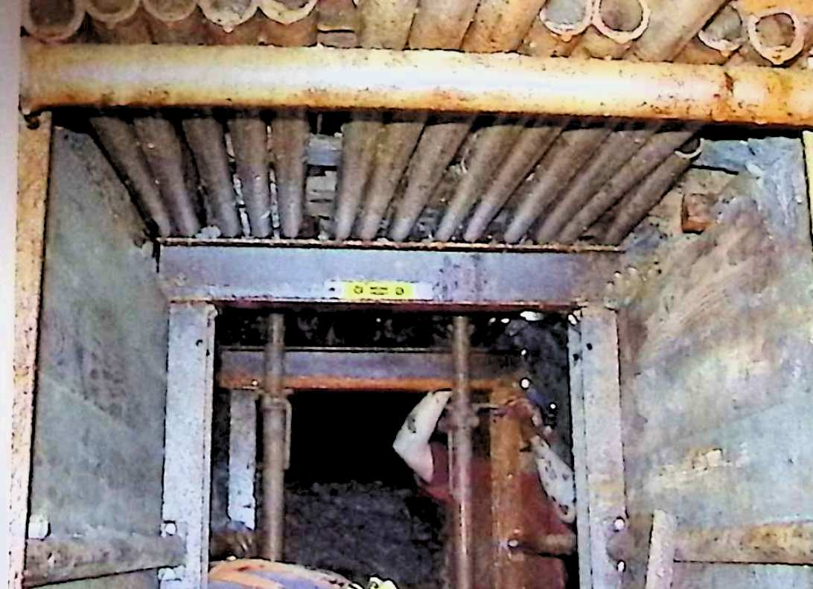
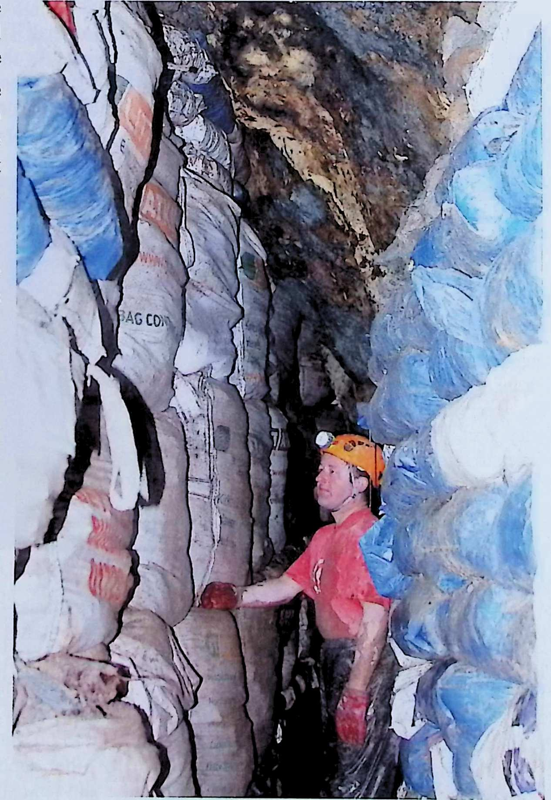
Horse Crag opening
Timeline:
2009-2015

Slide 6
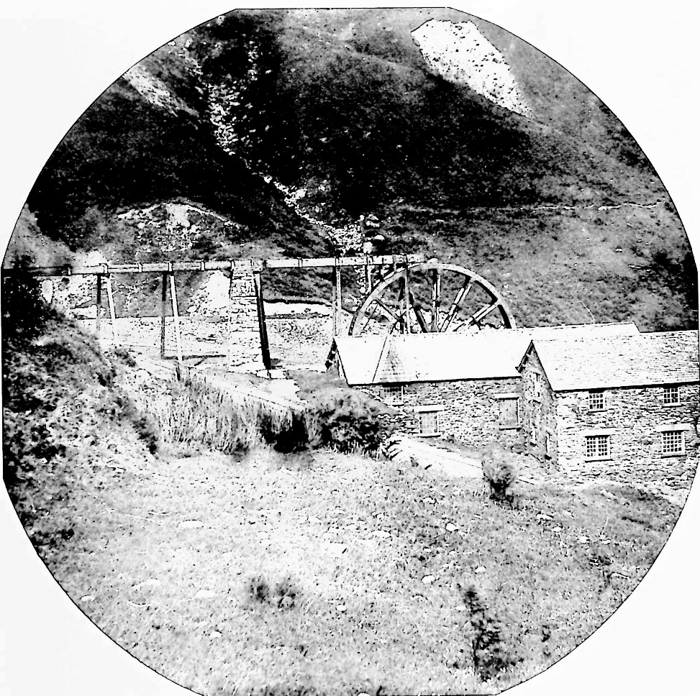
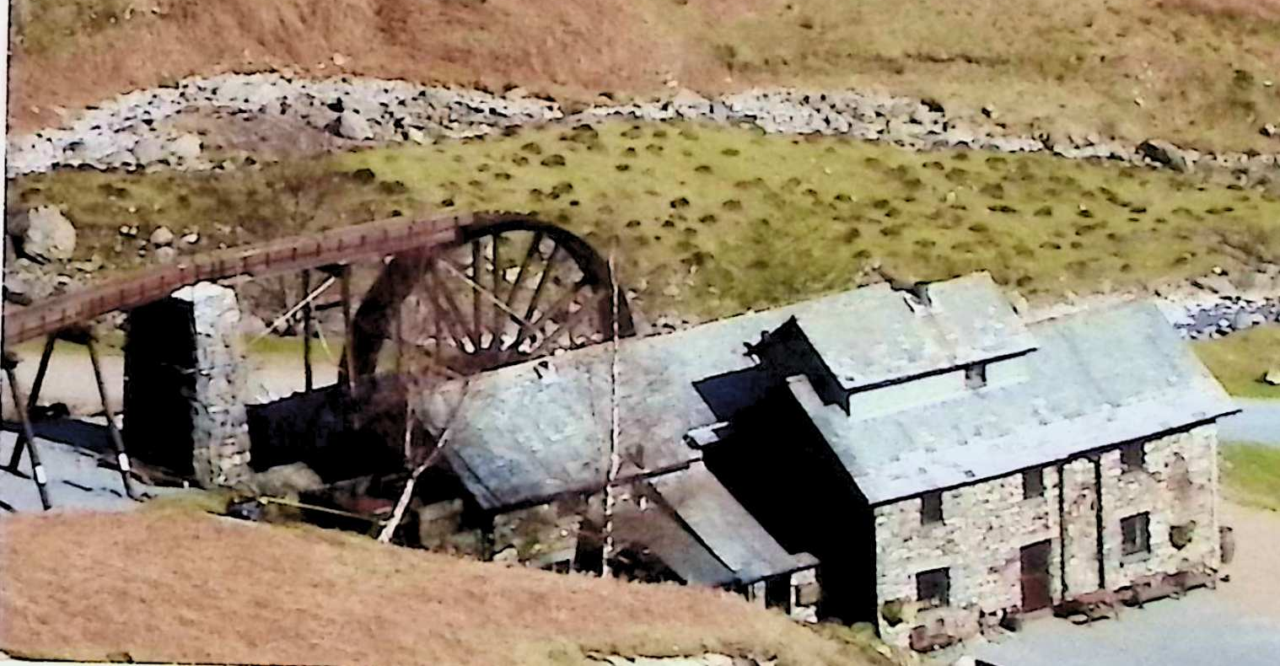
New wheel – Philip Johnson
Bonsor dressing floor
Timeline:
1892-2022

Slide 7
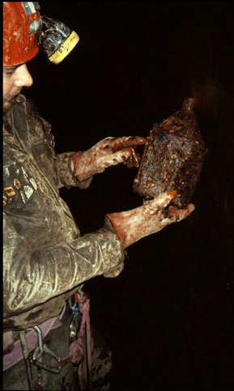
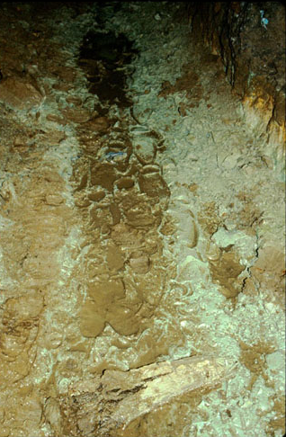
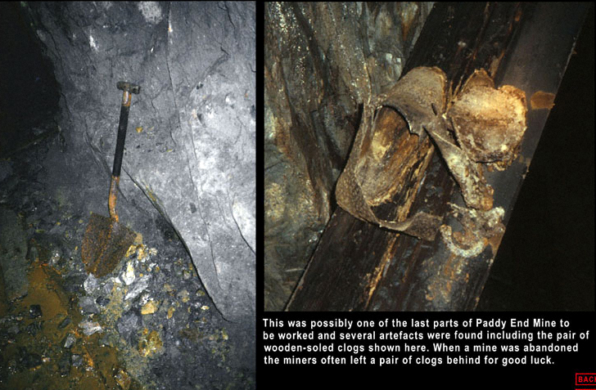
Clog prints and personal gear
Timeline:
1980s

Slide 8
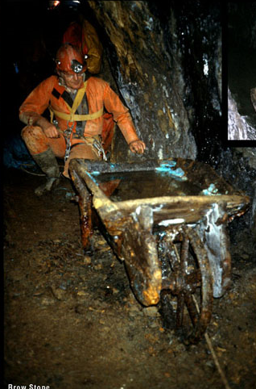
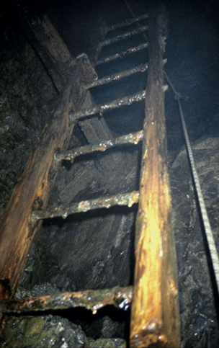
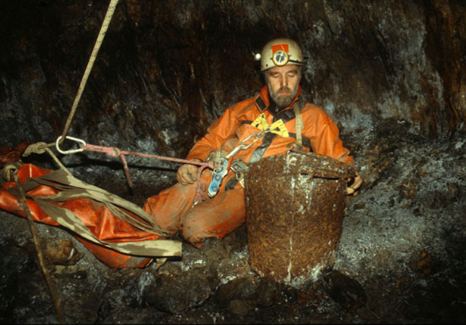
Tools
Timeline:
1980s

Slide 9
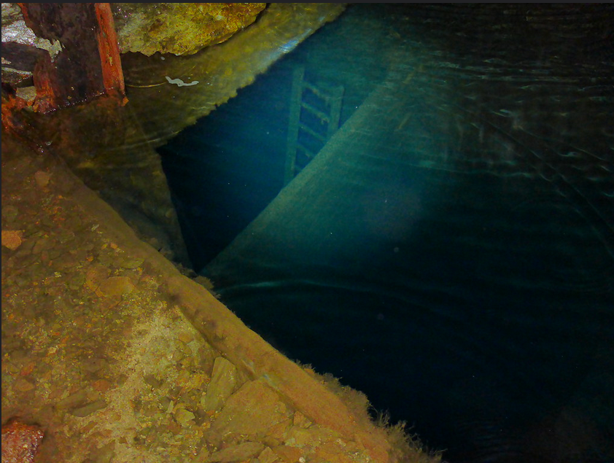
Ladders
Timeline:
1980s

Slide 10
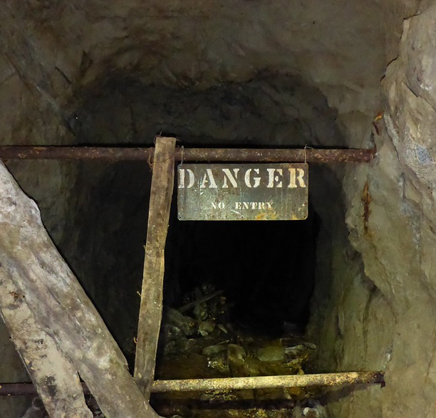
STAY OUT, STAY ALIVE!

Slide 11
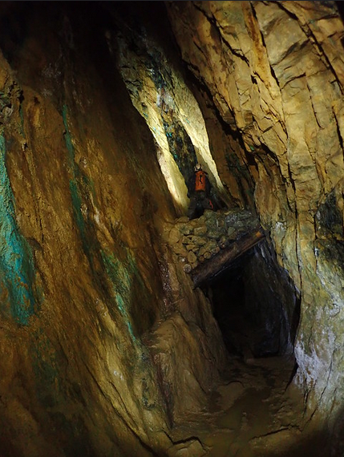
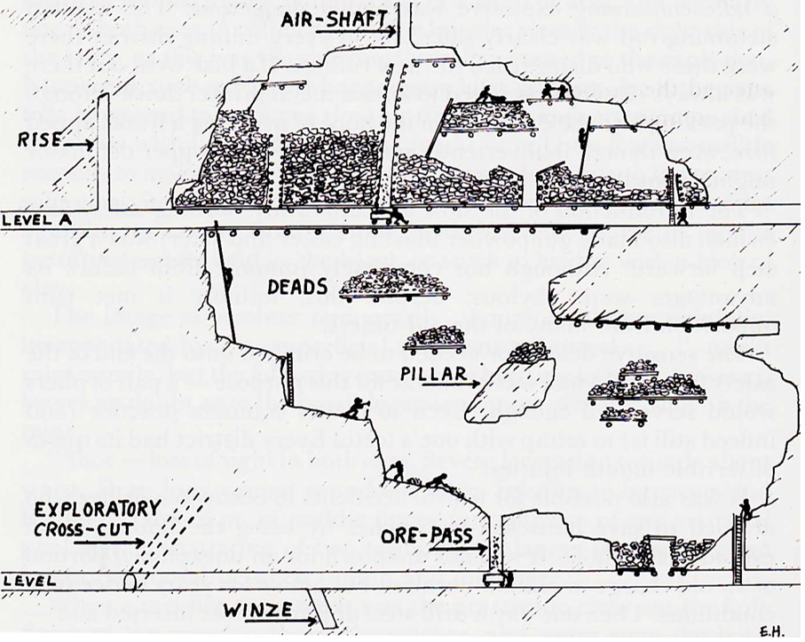
False floors – better on or below?
Timeline:
Present day

Slide 12
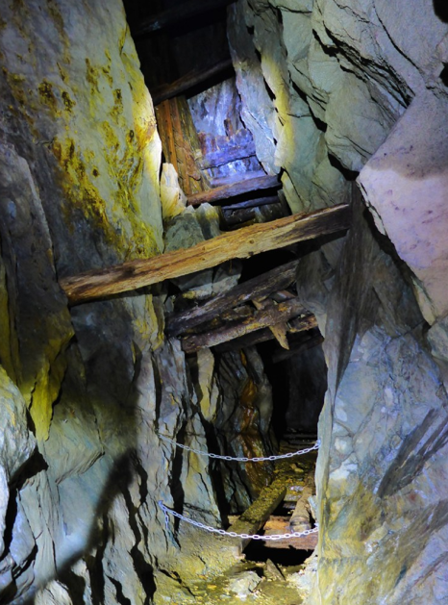
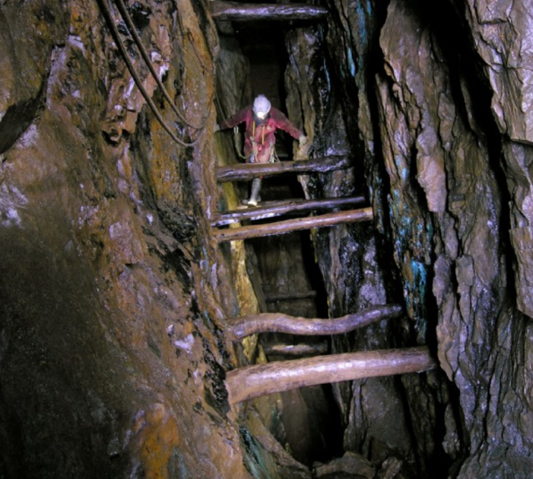
Above the abyss!
Timeline:
Present day

Slide 13
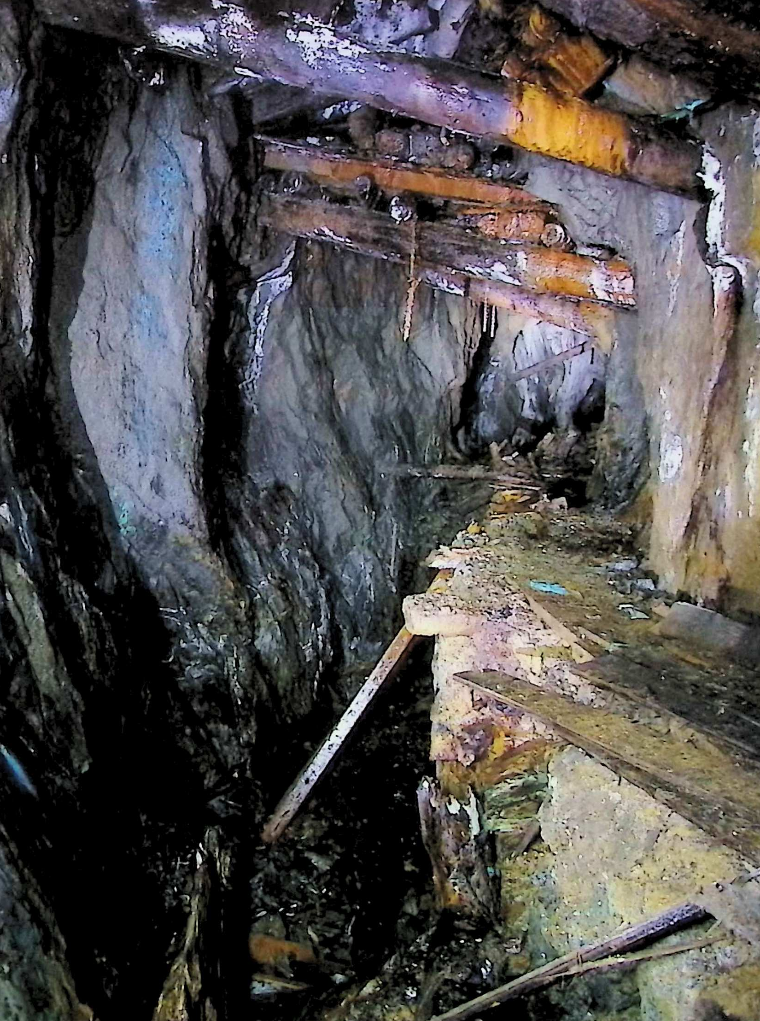
Collapsed levels
Timeline:
Present day

Slide 14
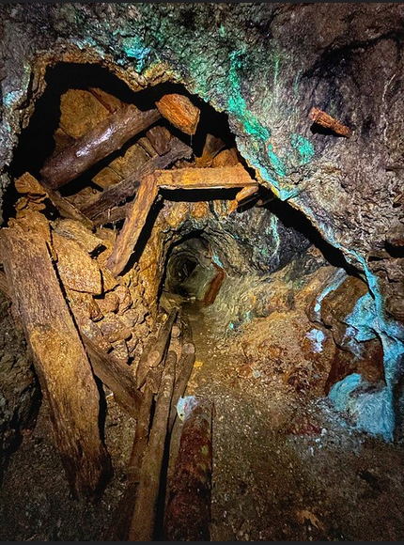
Crushed supports
Timeline:
Present day

Slide 15
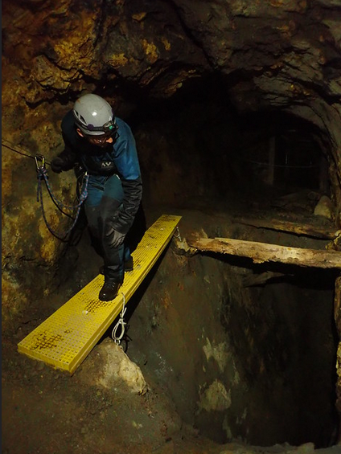
Safety gear essential
Timeline:
Present day

Slide 16
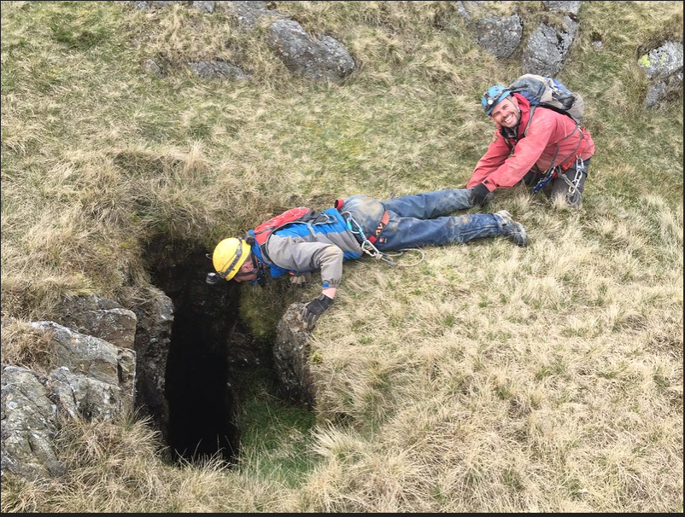
Is the safety message getting through?
Timeline:
Present day

Slide 17
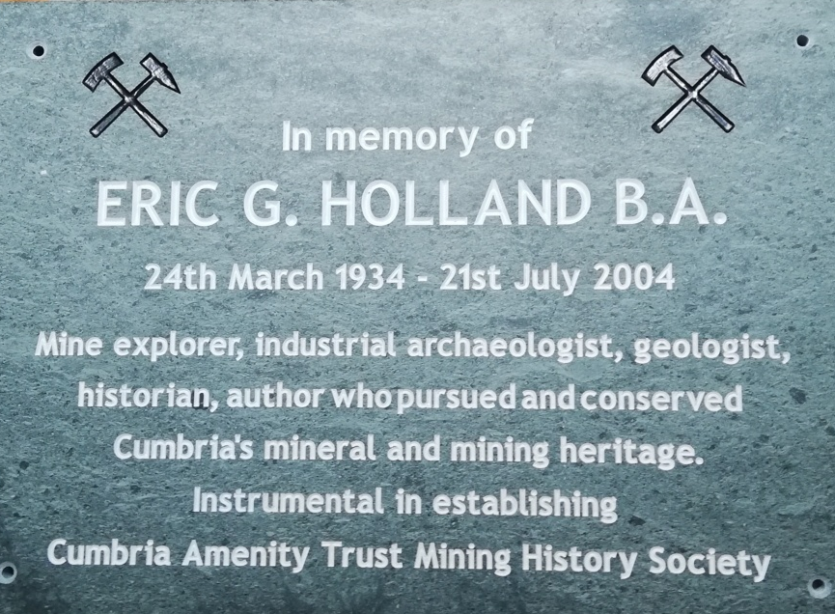
IN MEMORY

Slide 18
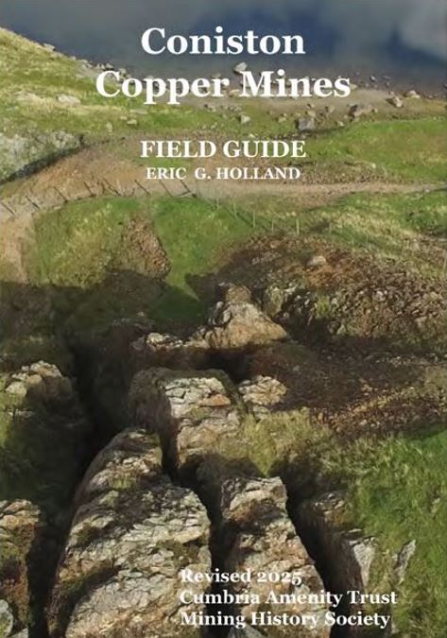
Eric’s Field Guide revised and reprinted
Timeline: 2025

Slide 19
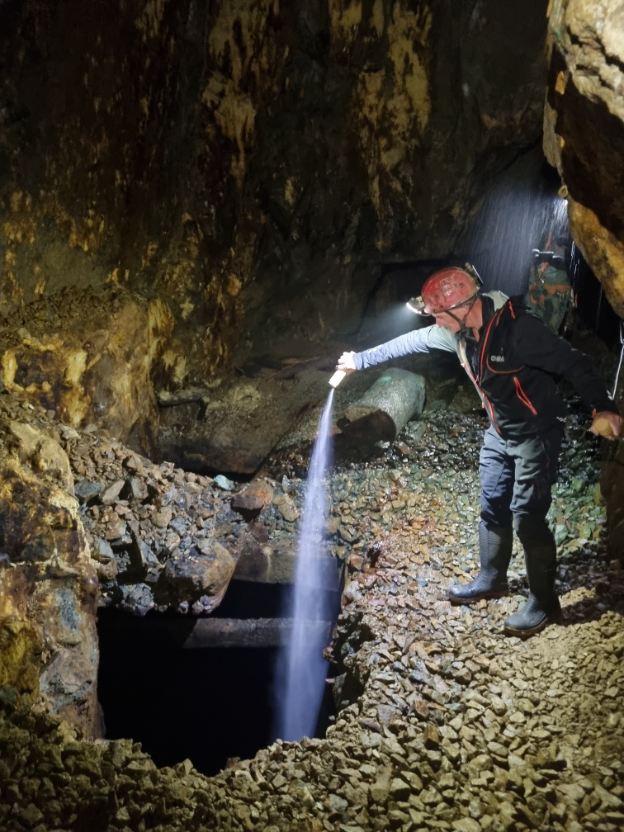
Scattering Eric’s ashes underground
Timeline: 2025

