Slide 1

Coniston Coppermines
Part 4
Stephe Cove October 2026
Miners and machinery
The final years

Slide 2
MINERS AND MACHINERY

Slide 3
It wasn’t just “miners” at the mine
Driller
Shot-firer
Stone picker
Bucker
Timberman
Mason
Engine man
Loader
Trammer
Roadman
Fitter
Blacksmith
Ore dresser
Mine captain

Slide 4
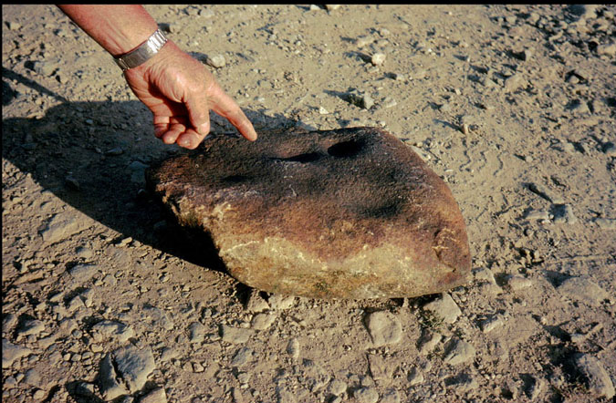
Working by hand – mortar stones

Slide 5
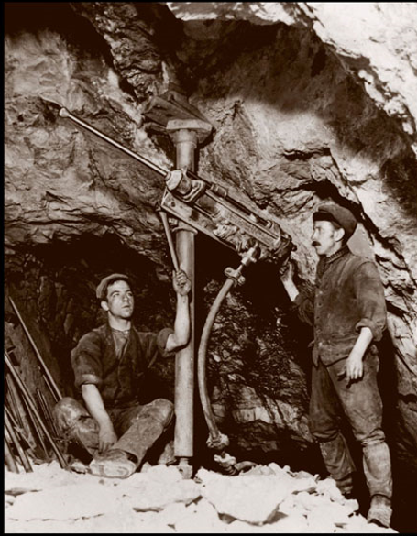
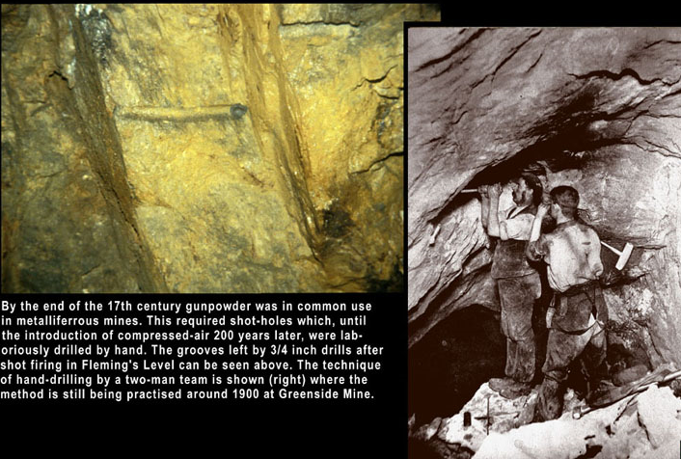
Drilling
Timeline:
Compressed air after 1883

Slide 6
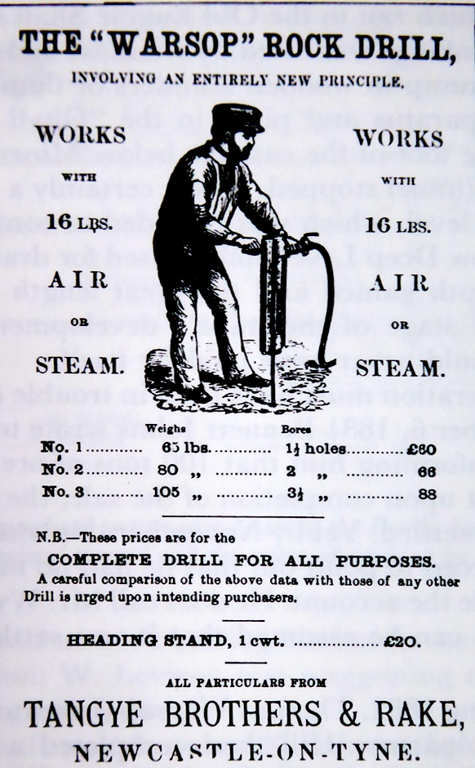
Compressors marked the end of hand drilling
Timeline: 1850

Slide 7
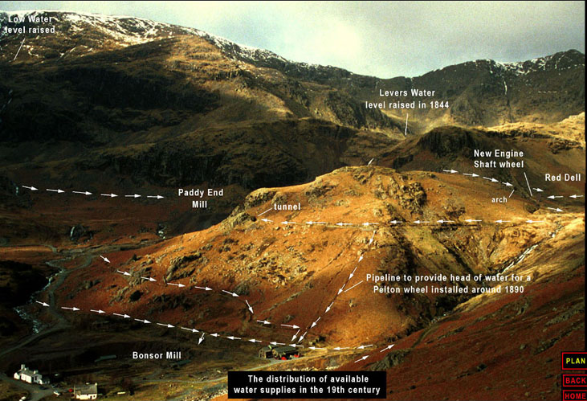
Leats took water from becks to wheels…
Timeline: late 1800s

Slide 8
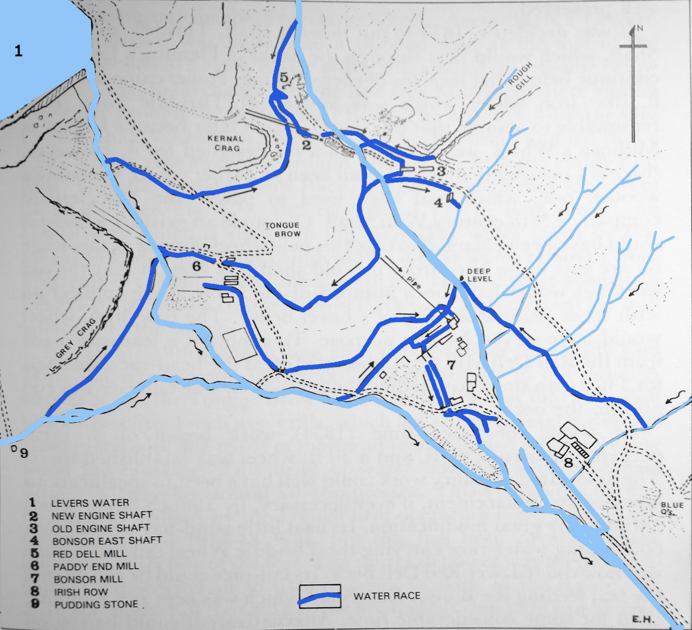
…using water over and over again
From Coniston Copper by Eric Holland

Slide 9
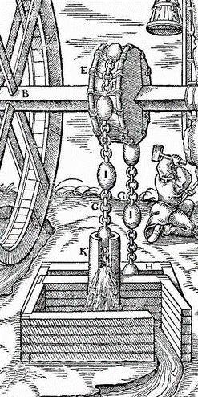
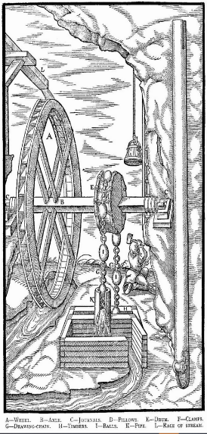
Early pumping - rag and chain
Timeline: 1500s

Slide 10
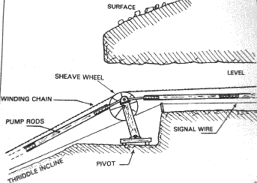
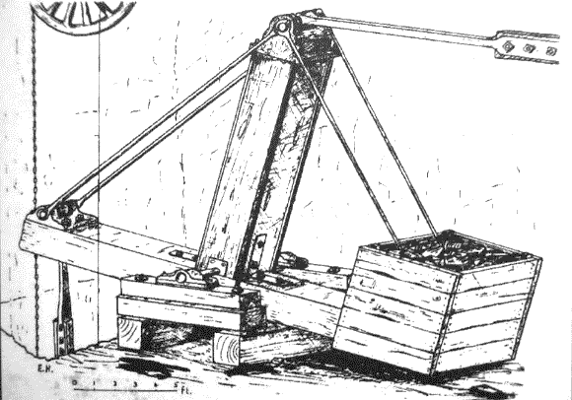
A pivot took the rods from the incline to the balance bob
Timeline: late 1700s

Slide 11
THE FINAL YEARS

Slide 12
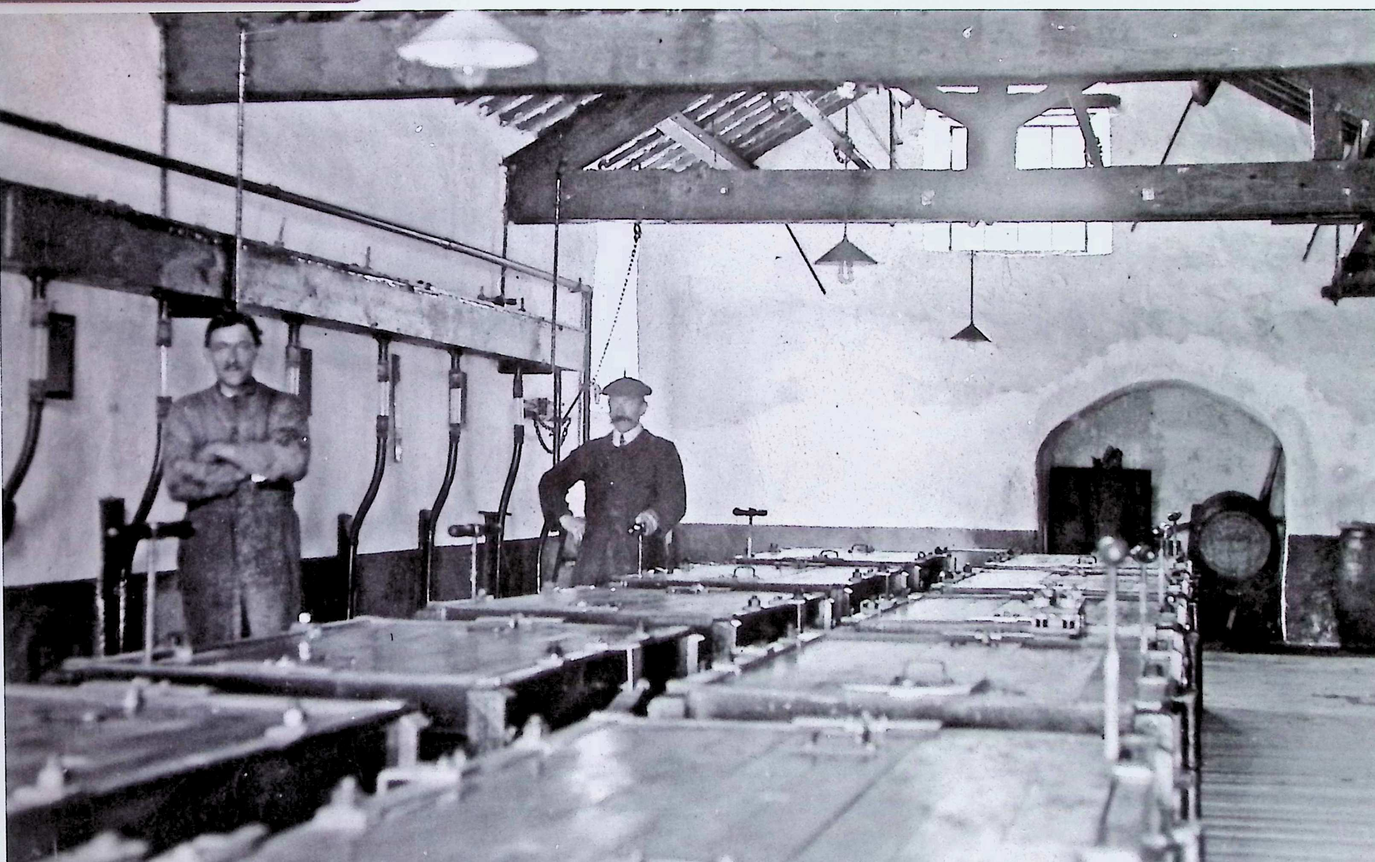
Electrolyte processing from old dumps
Timeline: 1912

Slide 13
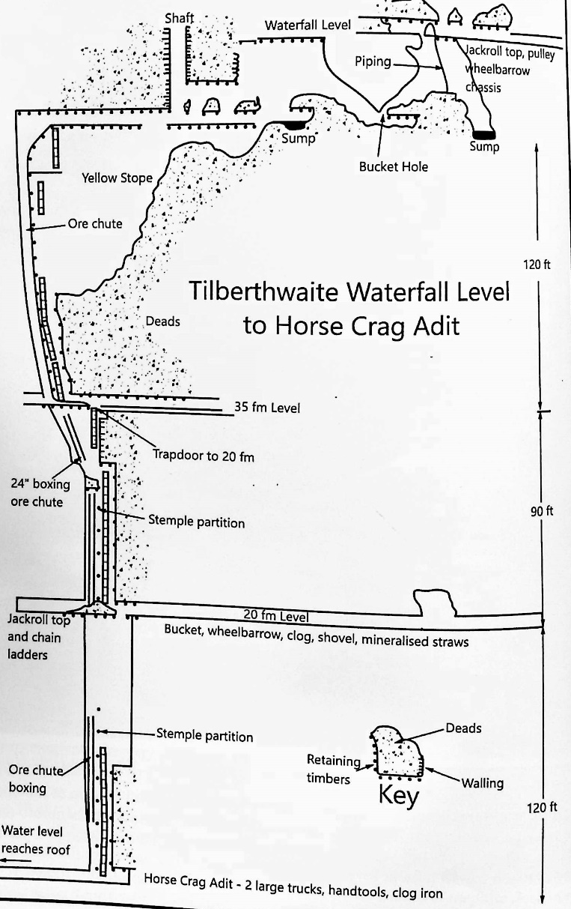
Mining ceased after Horse Level to surface was cleared but no ore was found
Timeline: 1942

Slide 14
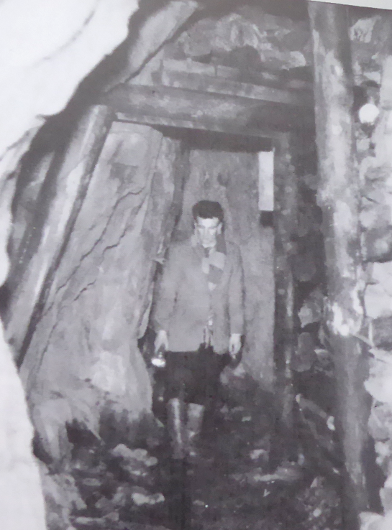
Shaw went round a dangerous collapse with a new tunnel
Timeline: 1950s

Slide 15
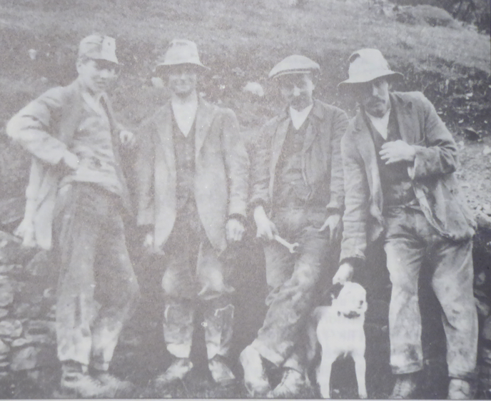
Drop in price for copper – you took down a pound and brought up 10 shillings
Timeline: 1950s

Slide 16
THE CONISTON COPPER PROJECT

Slide 17
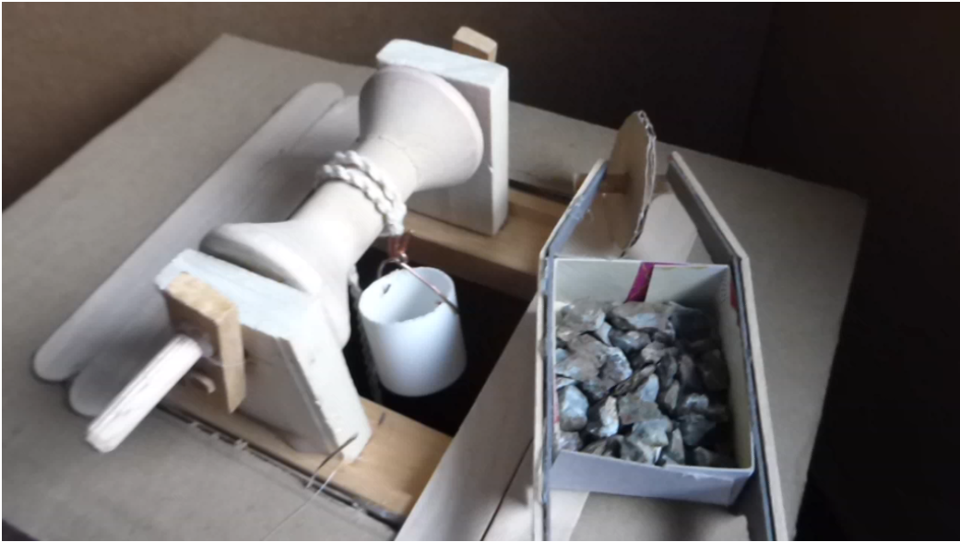
Jack Roll
Timeline: after 1590s

Slide 18
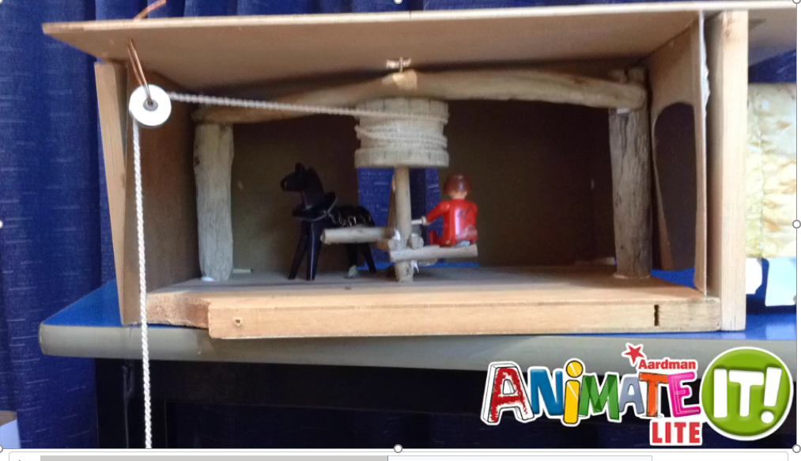
Horse gin - stop frame animation
Timeline: 1700s

Slide 19
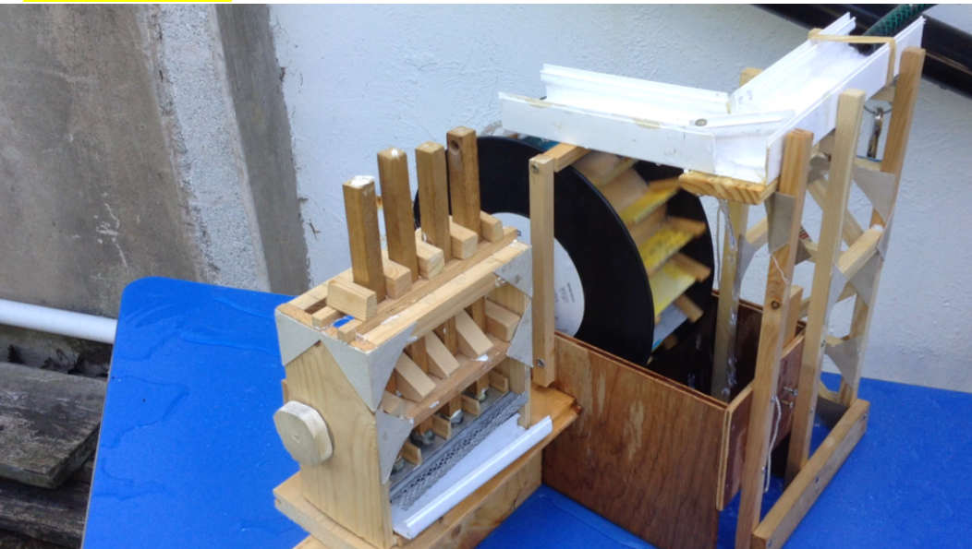
Water –powered stamps
Timeline: 1700s

Slide 20
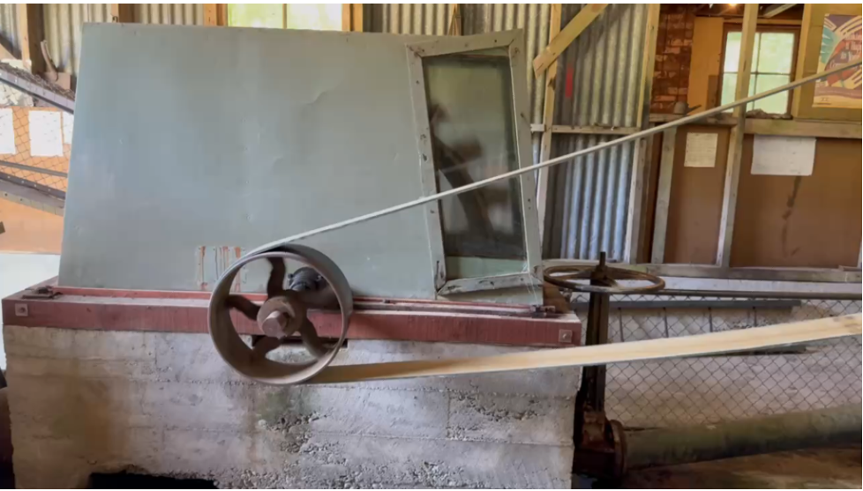
Rotating stamps in action - cams lifting up stamps
BREAKING UP THE ORE

Slide 21
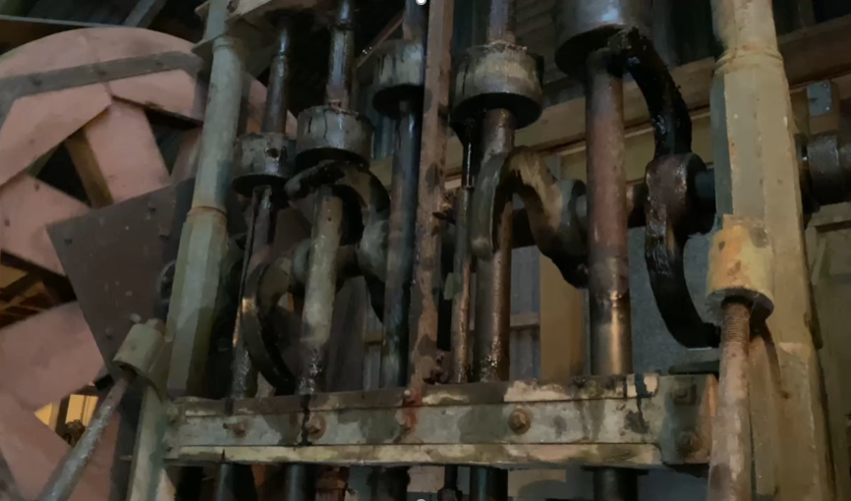
Rotating stamps in action - cams rotating stamps
BREAKING UP THE ORE

Slide 22
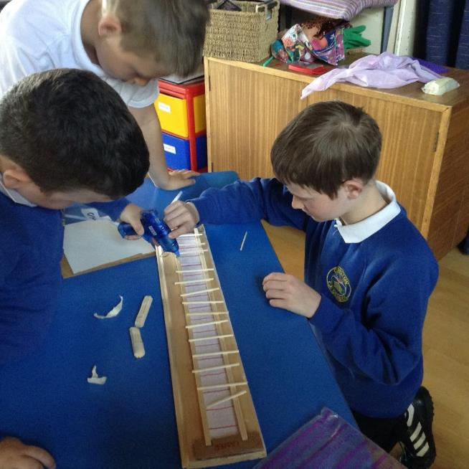
Model makers at work

Slide 23
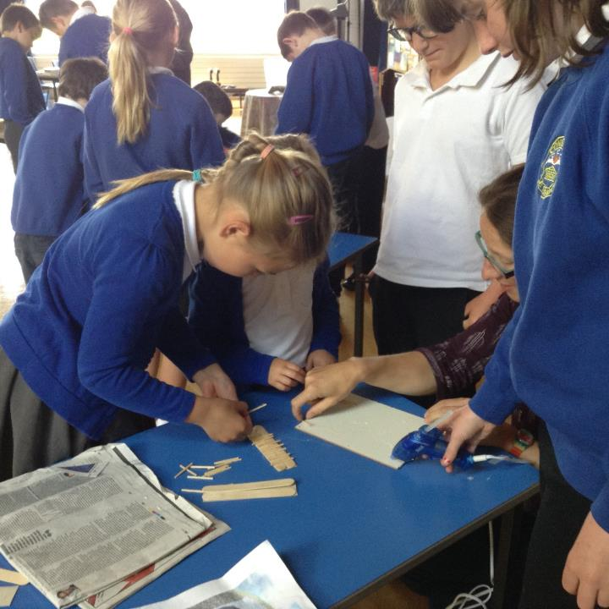

Slide 24
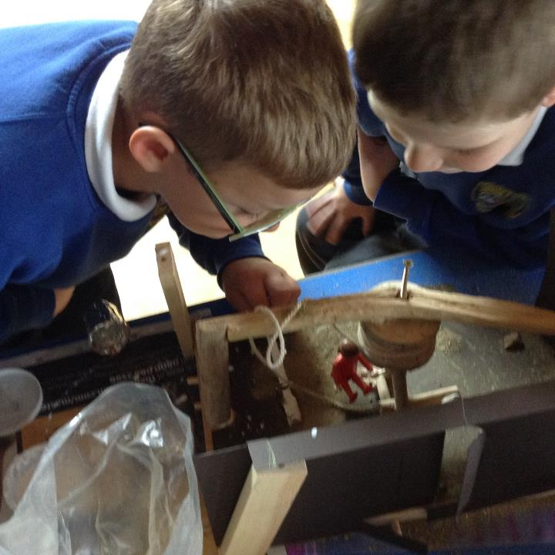

Slide 25
