Slide 1

Coniston Coppermines
Part 3
Stephe Cove October 2026
450 years of history

Slide 2


450 YEARS OF CONISTON HISTORY

Slide 3
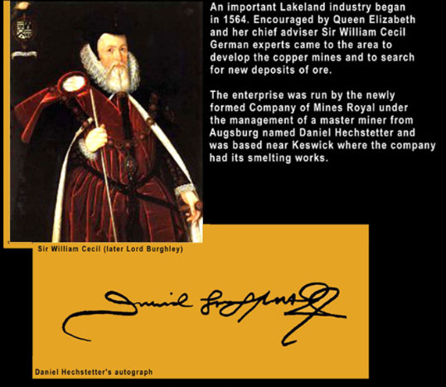
Company of Mines Royal 1564

Slide 4

German miners to 1620
Timeline: 1599

Slide 5
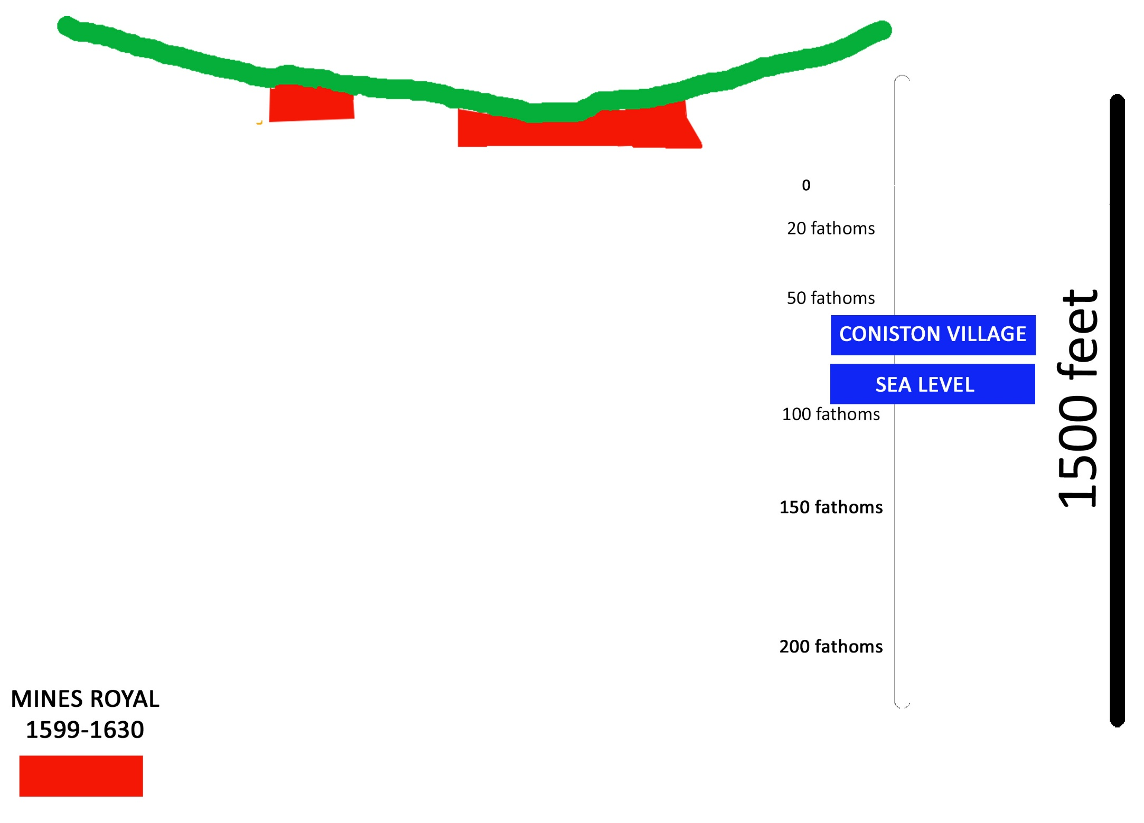

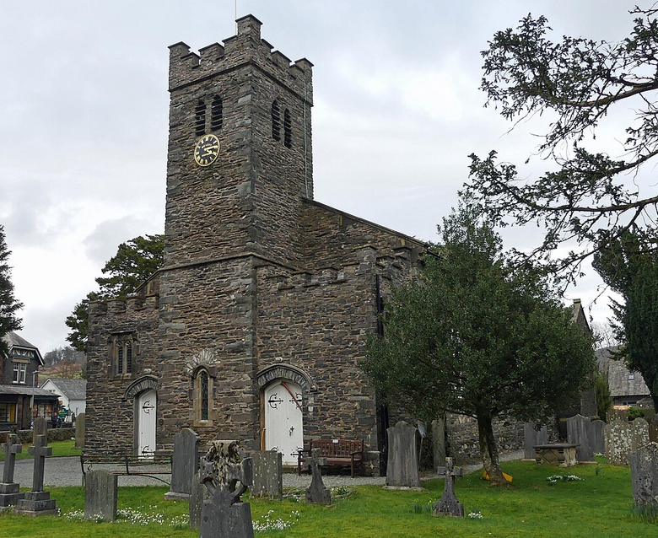
St Andrew’s Church – to give scale

Slide 6
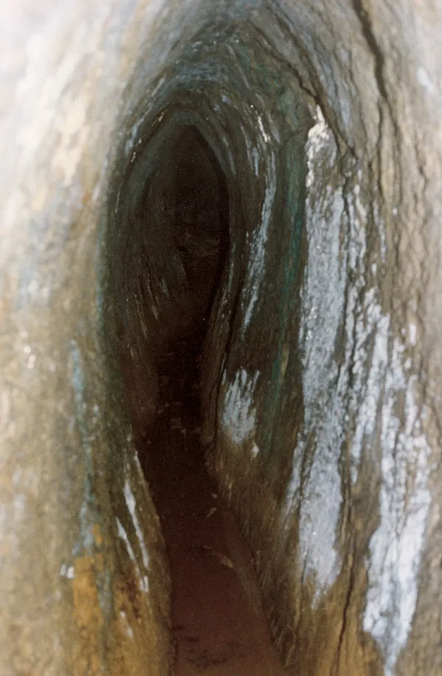
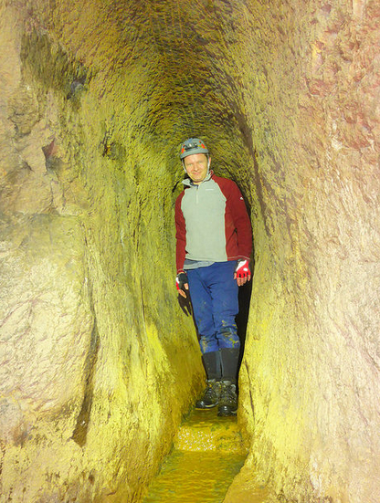
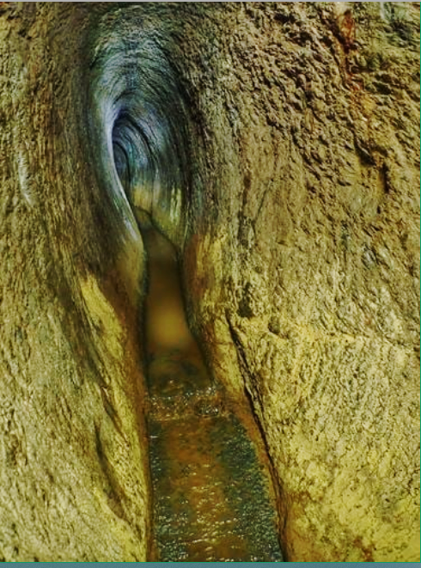
Coffin levels
Timeline: late 1500s

Slide 7
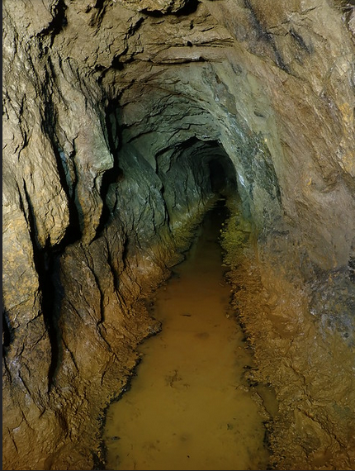
Drainage rather than pumping
Timeline: 1500s

Slide 8
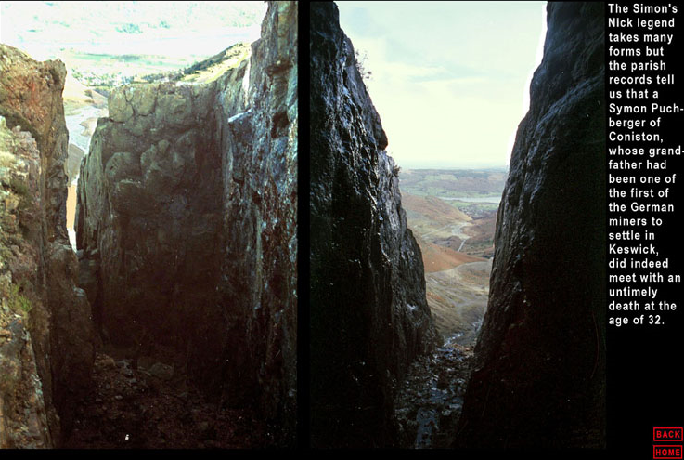
Outcropping ore – Simon’s Nick
Timeline: before the Civil War 1640s

Slide 9
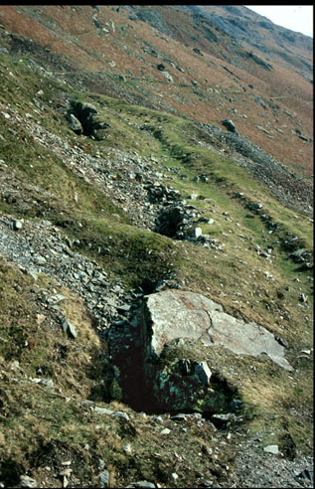
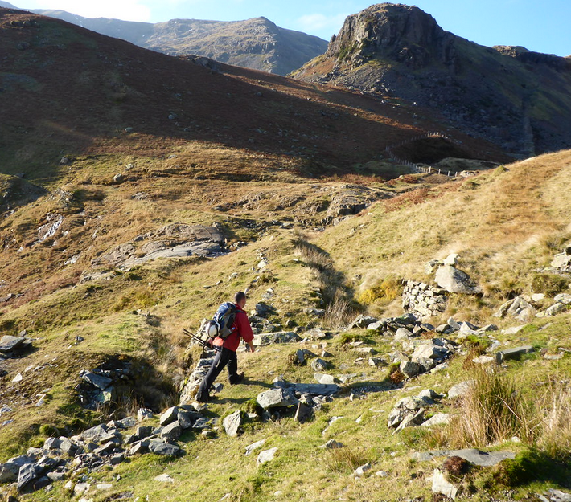
Outcropping ore – White Works
Timeline: Civil War 1640s

Slide 10
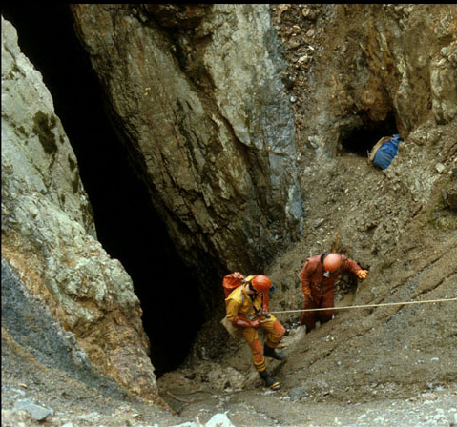
Below Simon’s Nick
Timeline: mid 1600s

Slide 11
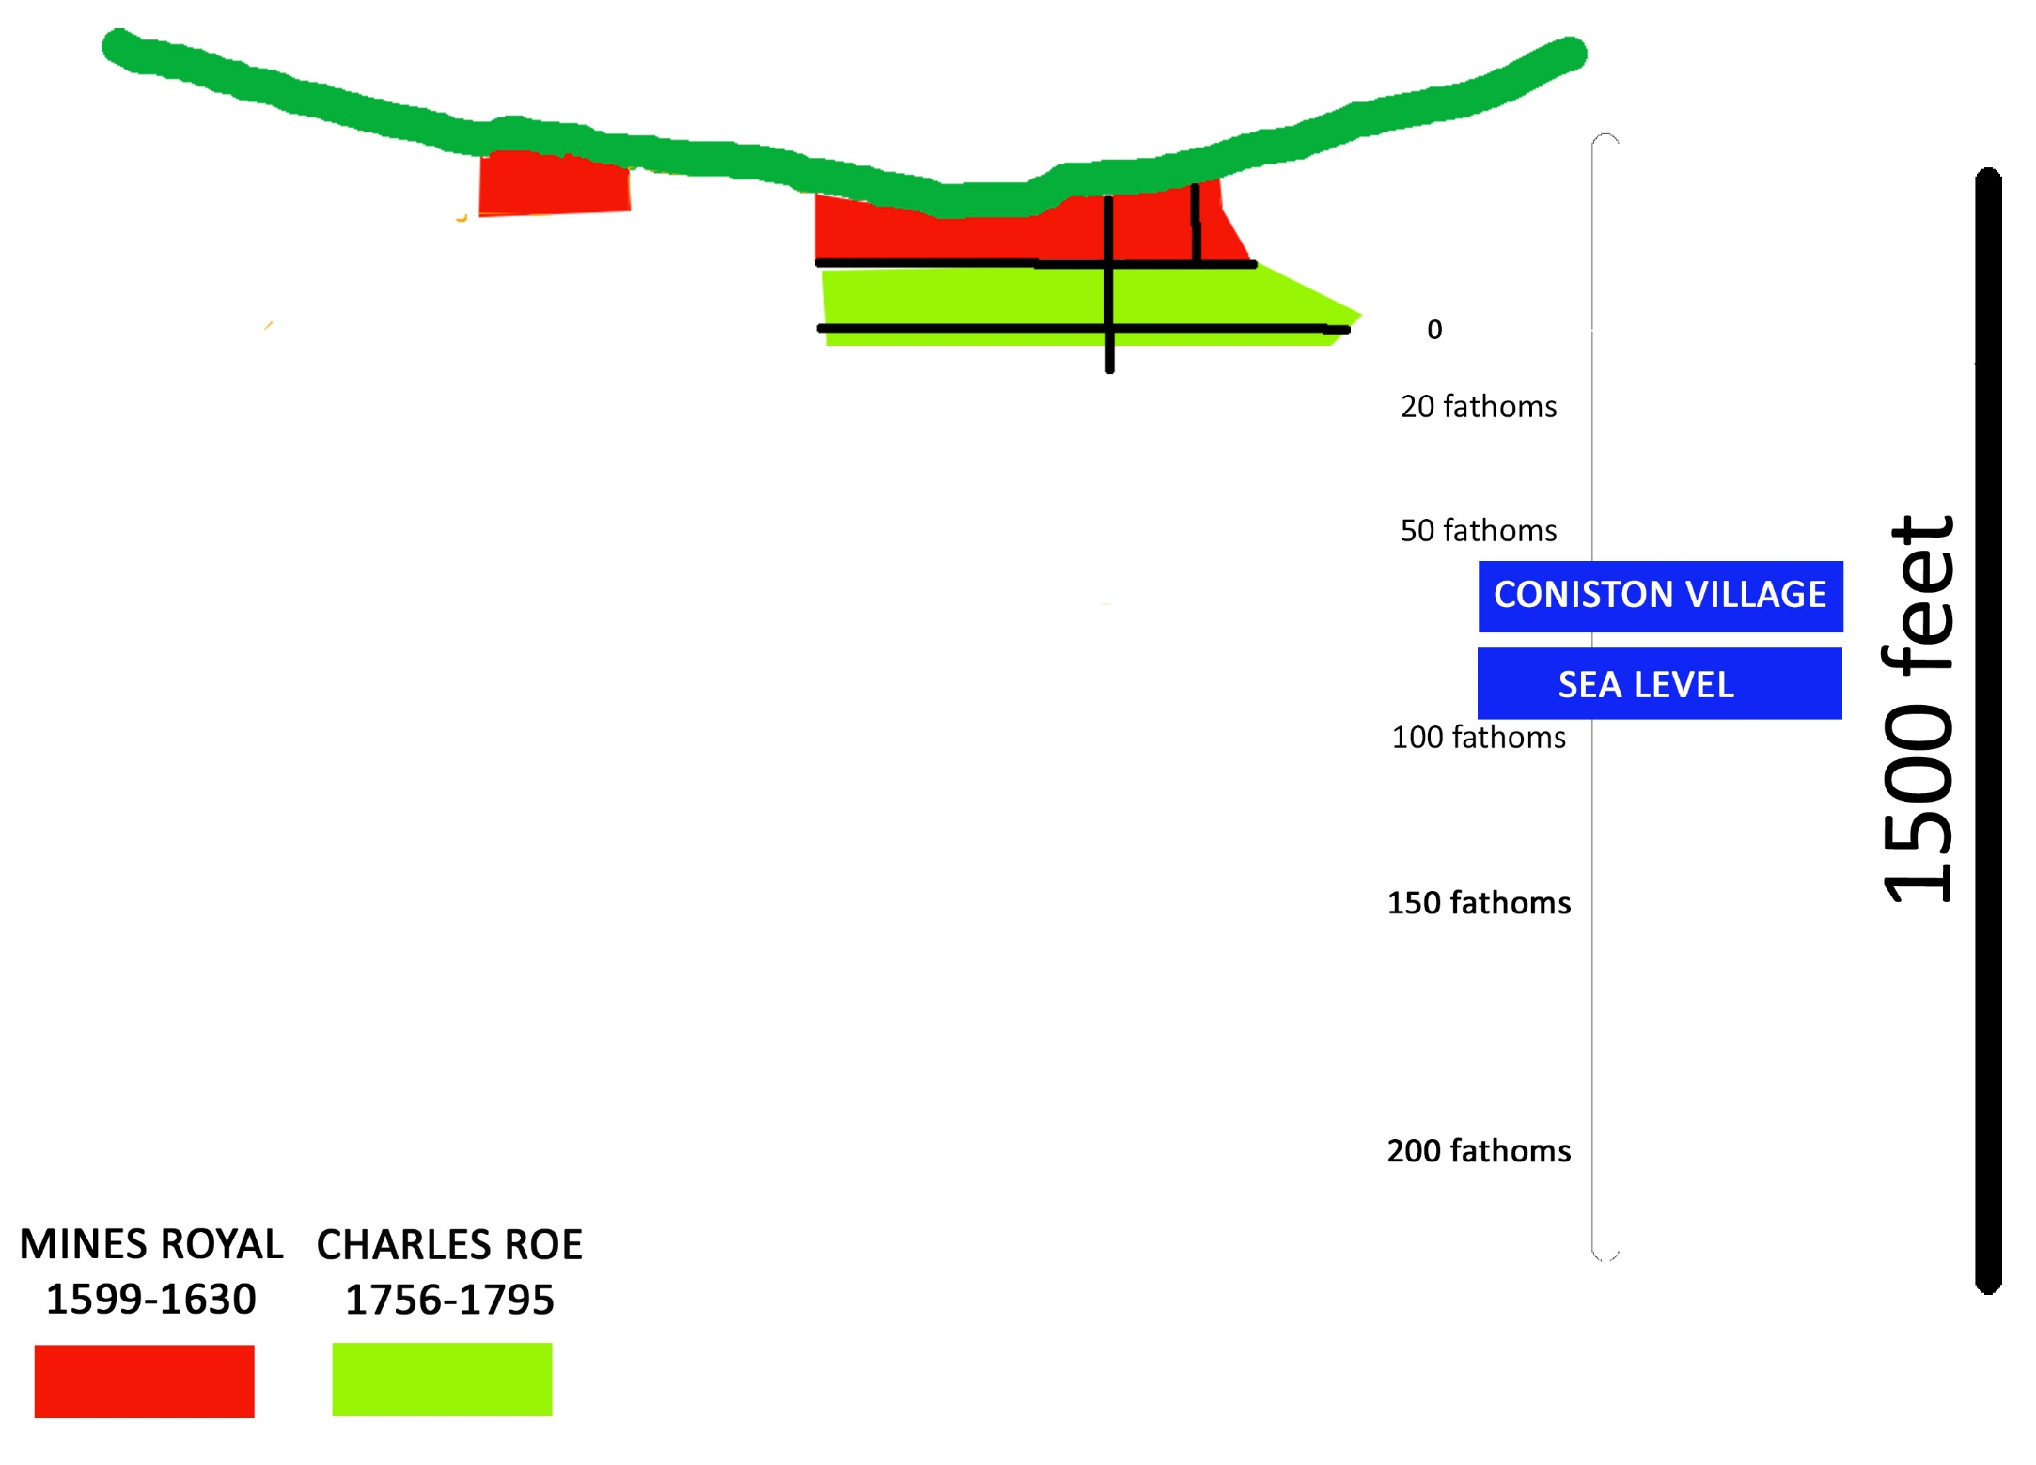
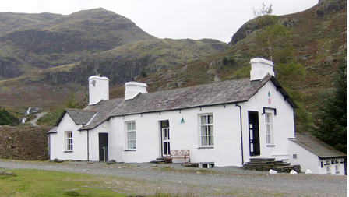
Road level at Youth Hostel

Slide 12
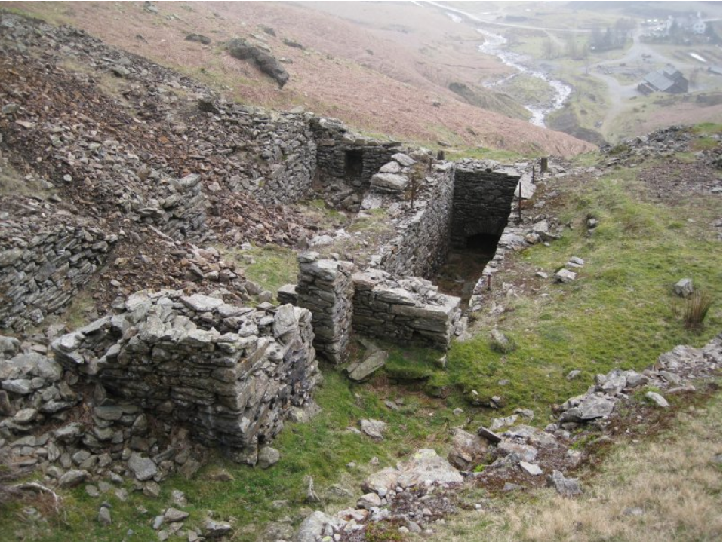
East Bonsor Shaft
Timeline: 1760

Slide 13
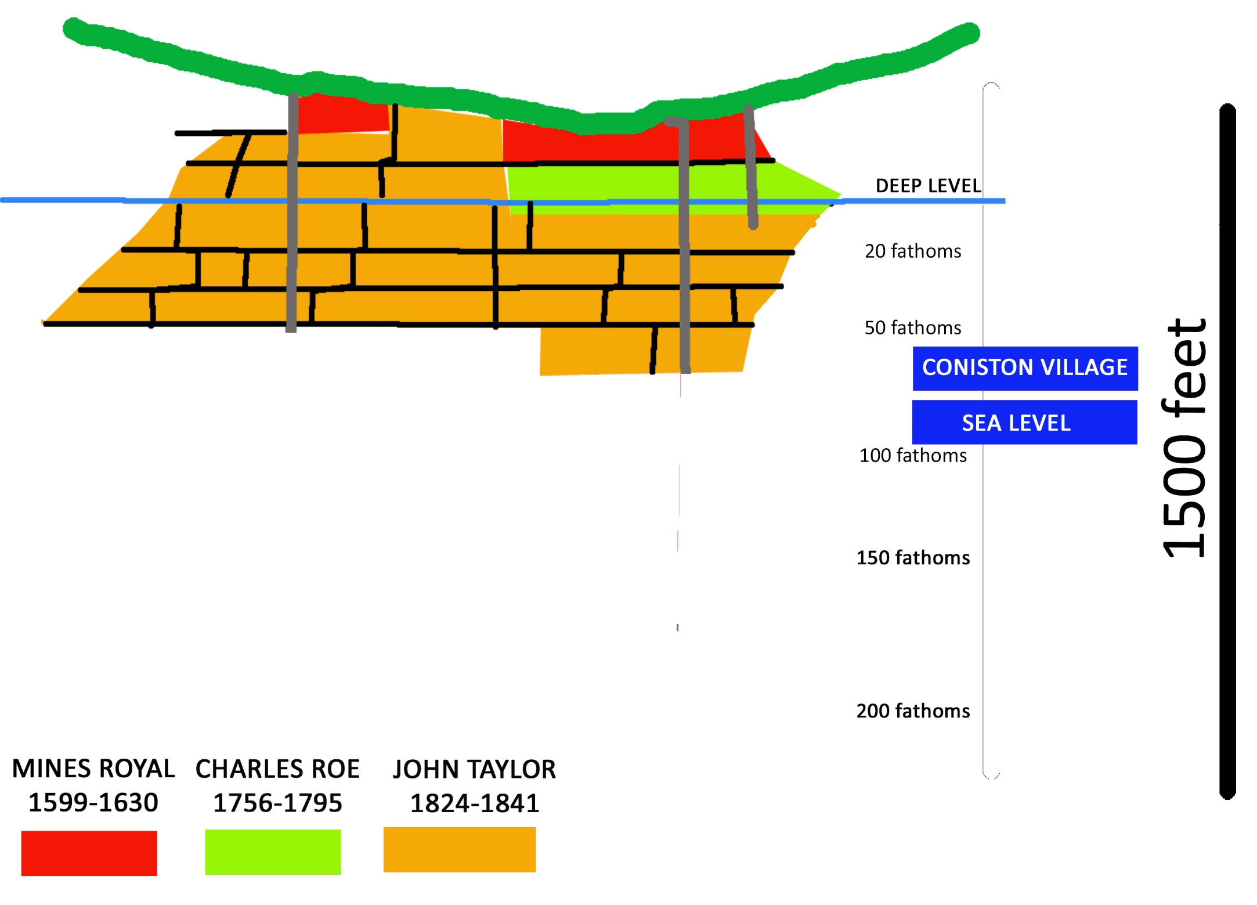

Slide 14
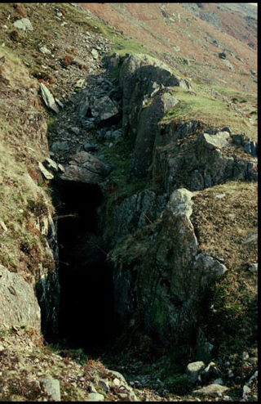
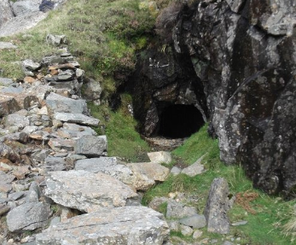
Adits connecting the surface to the veins
Timeline: early 1800s

Slide 15
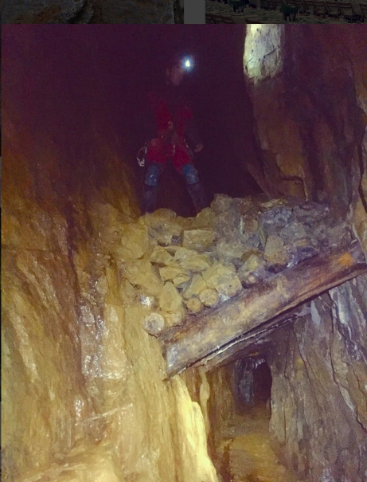
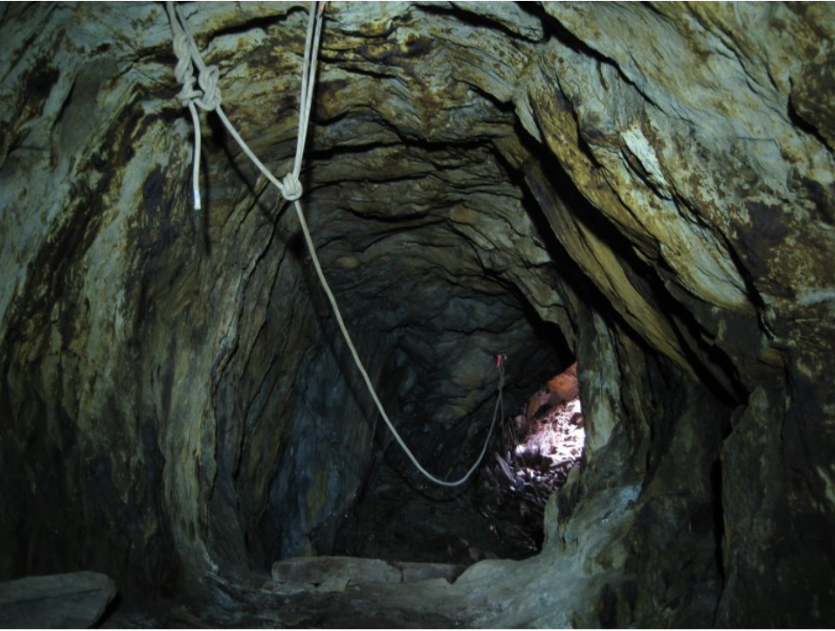
Old Engine Shaft connecting to lower levels
Timeline: early 1800s

Slide 16
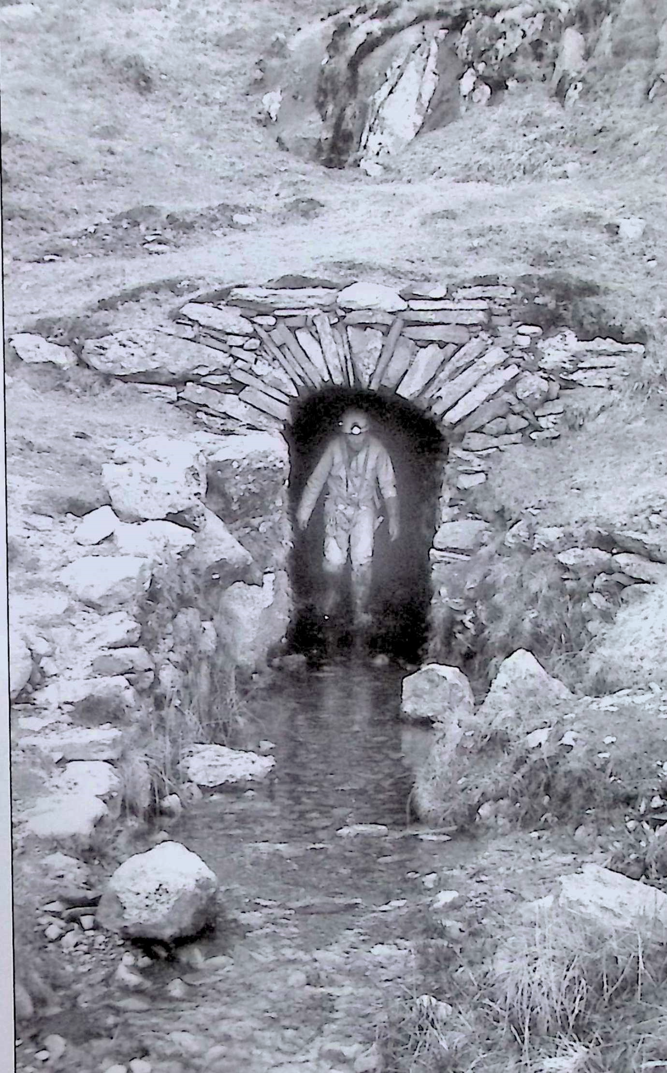
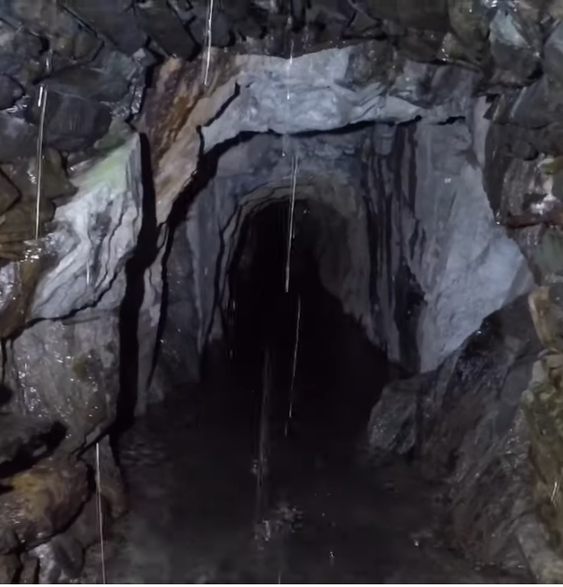
Deep Level - linking and draining
Timeline: 1825

Slide 17
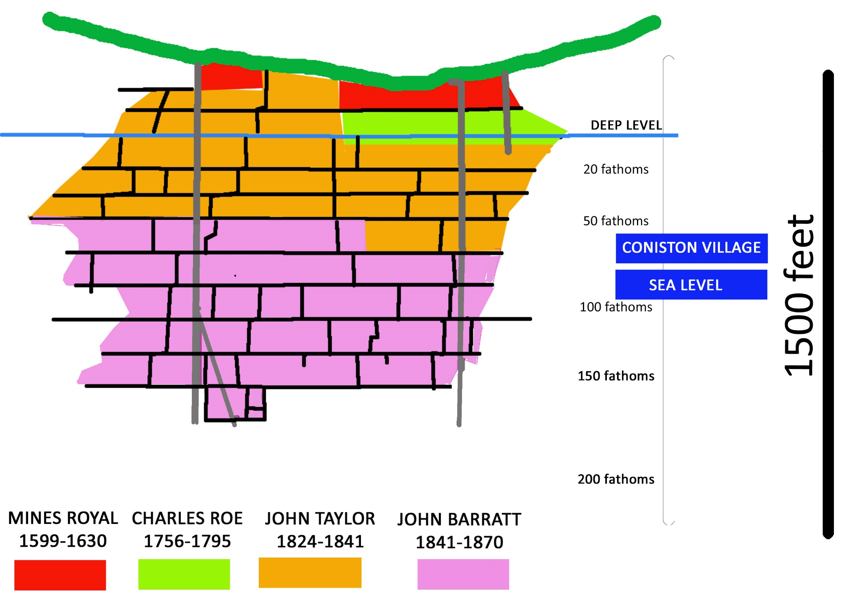

Slide 18
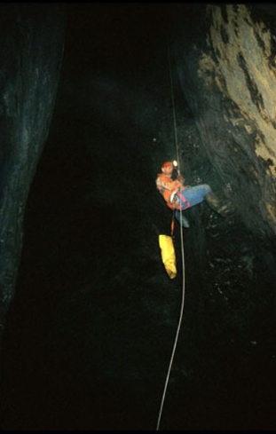
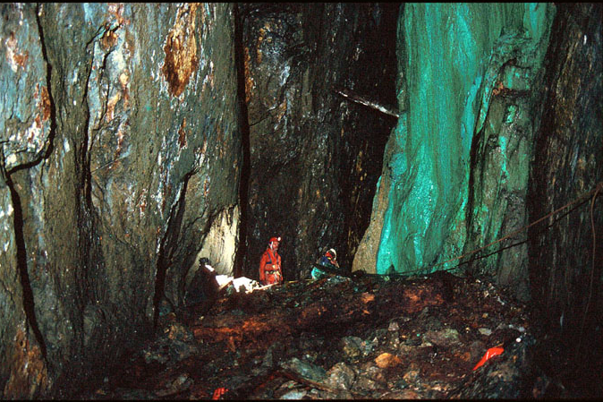
Barrett raised 3000 tons each year but after 1884 it never exceeded 200 tons
Timeline: 1850-1884

Slide 19
