Slide 1

Coniston Coppermines
Part 2
Stephe Cove October 2026
Getting your bearings

Slide 2
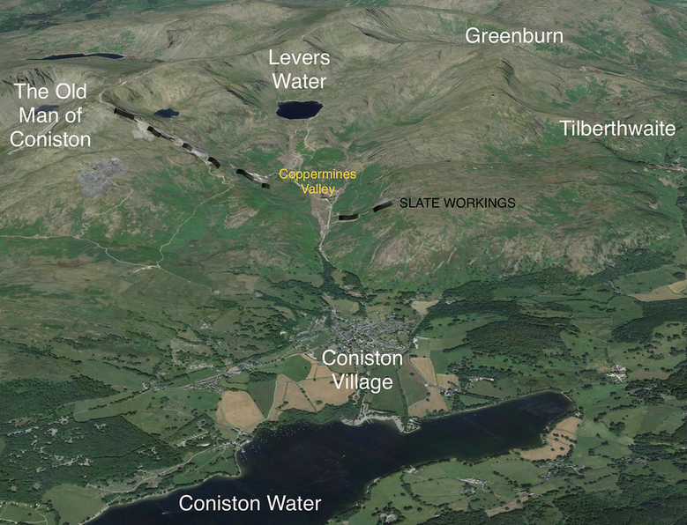
GETTING YOUR BEARINGS

Slide 3
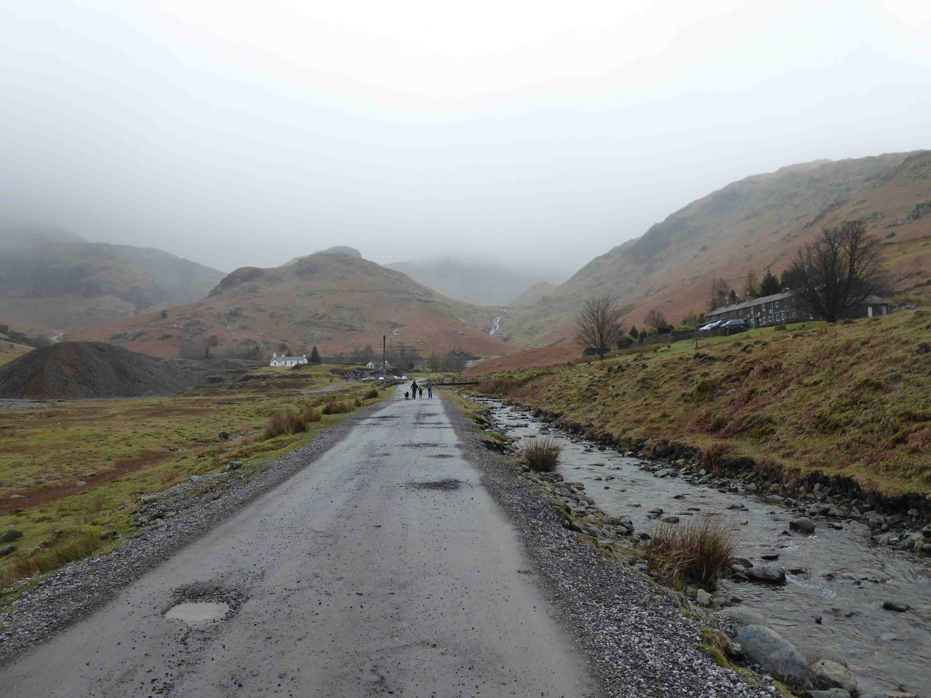
Looking Back in Coppermines Valley
Youth Hostel
Cottages

Slide 4
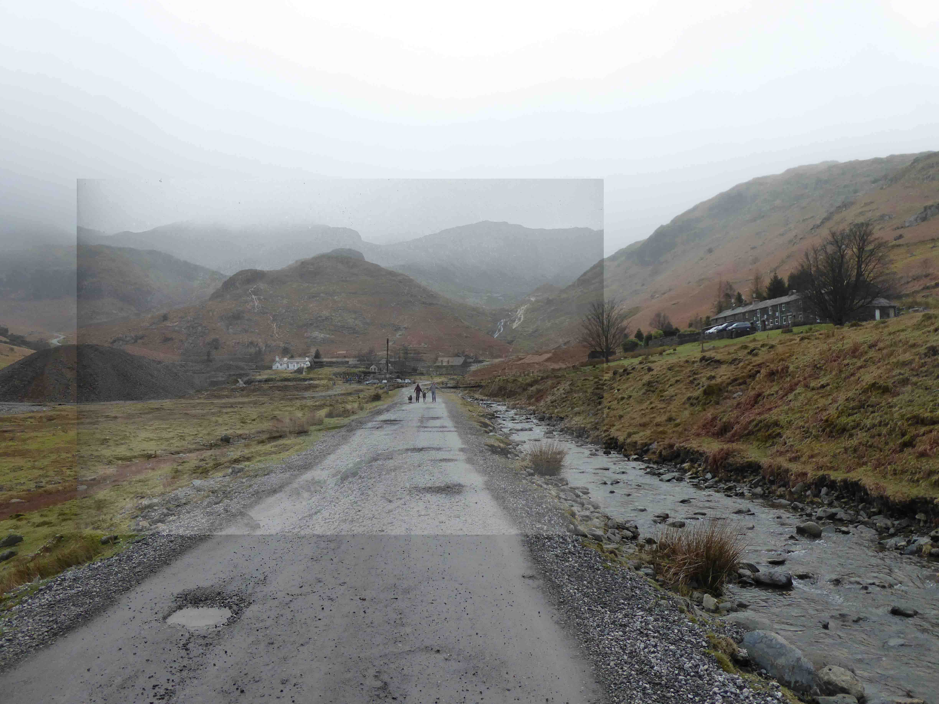

Slide 5
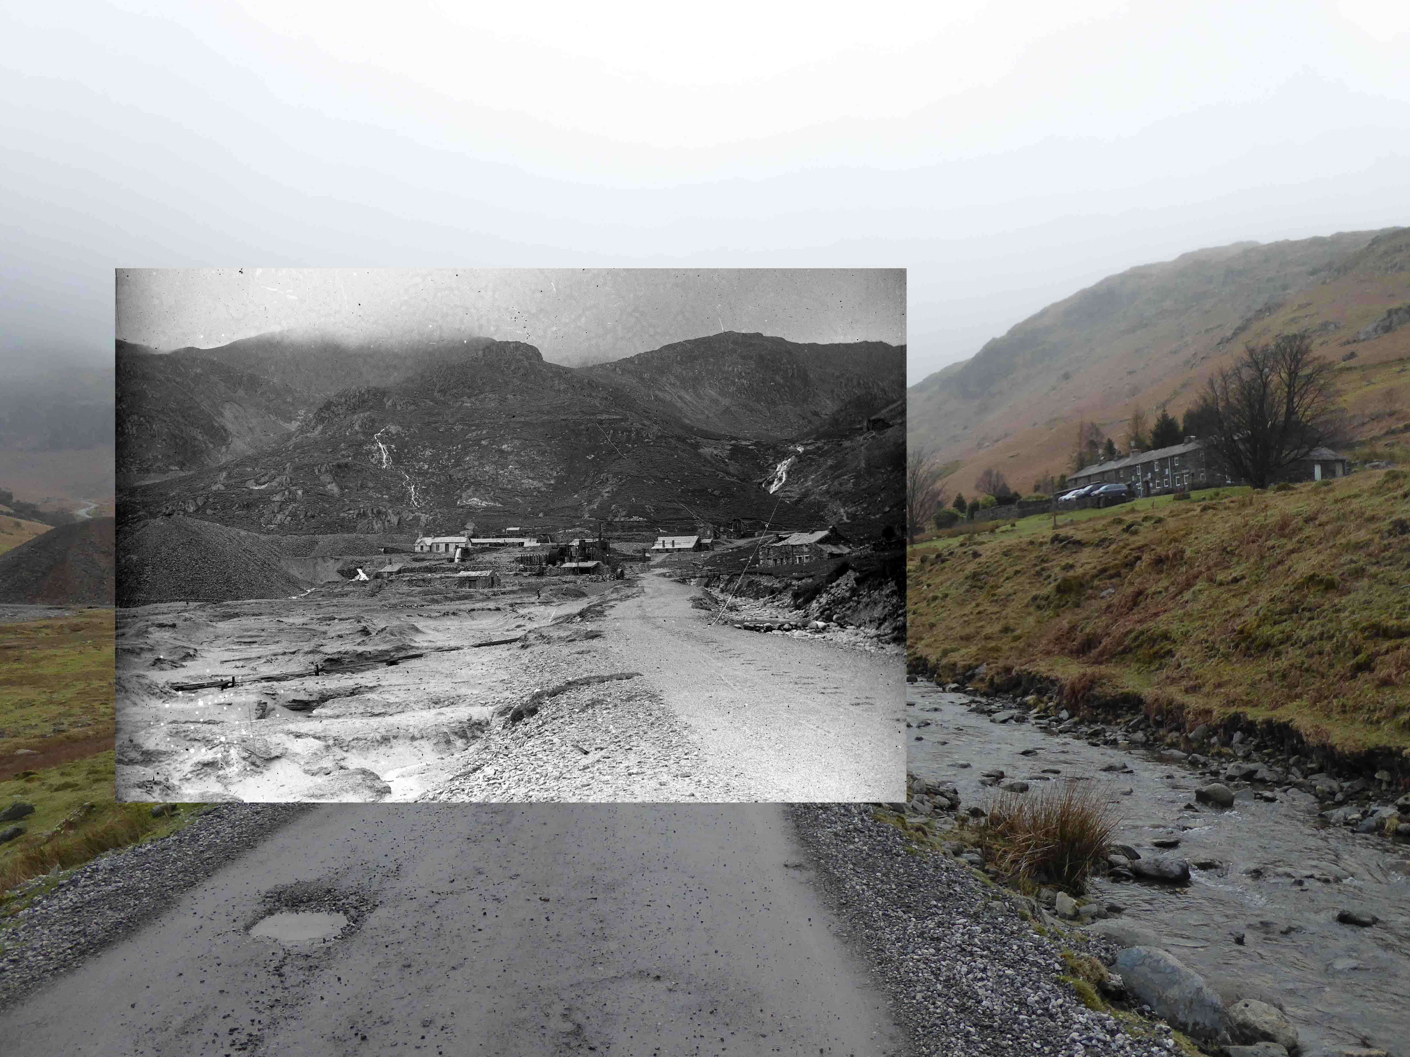

Slide 6
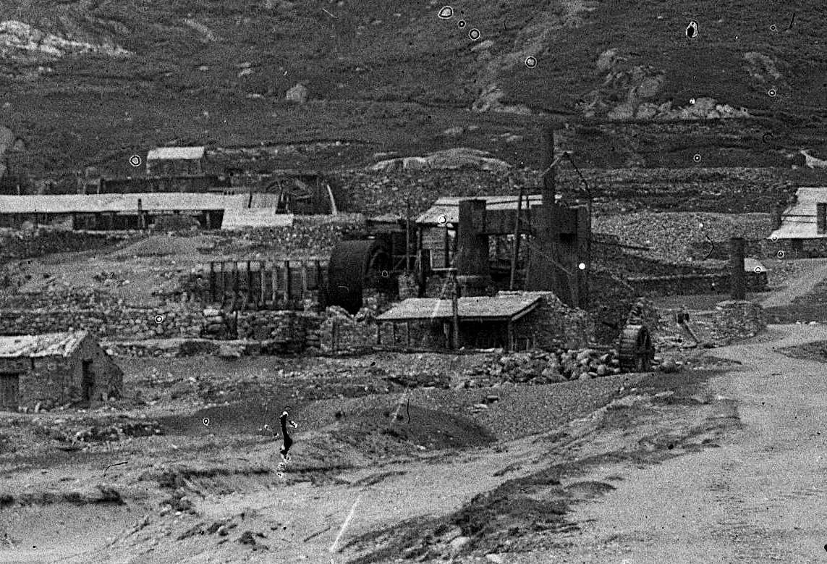

Slide 7
Looking Under Coppermines Valley
Skyline
Old Engine Shaft
Deep Level

Slide 8
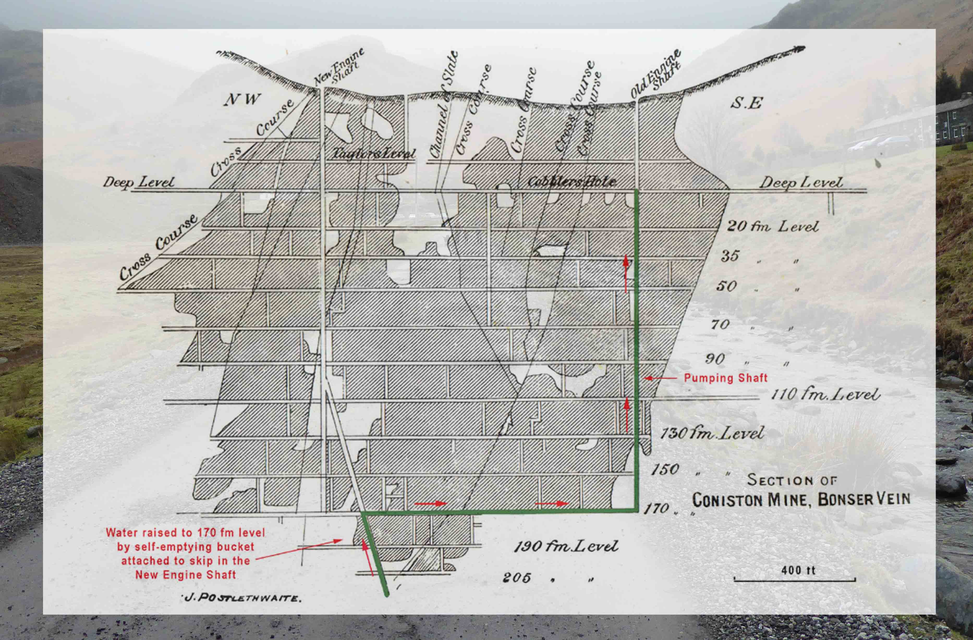

Slide 9
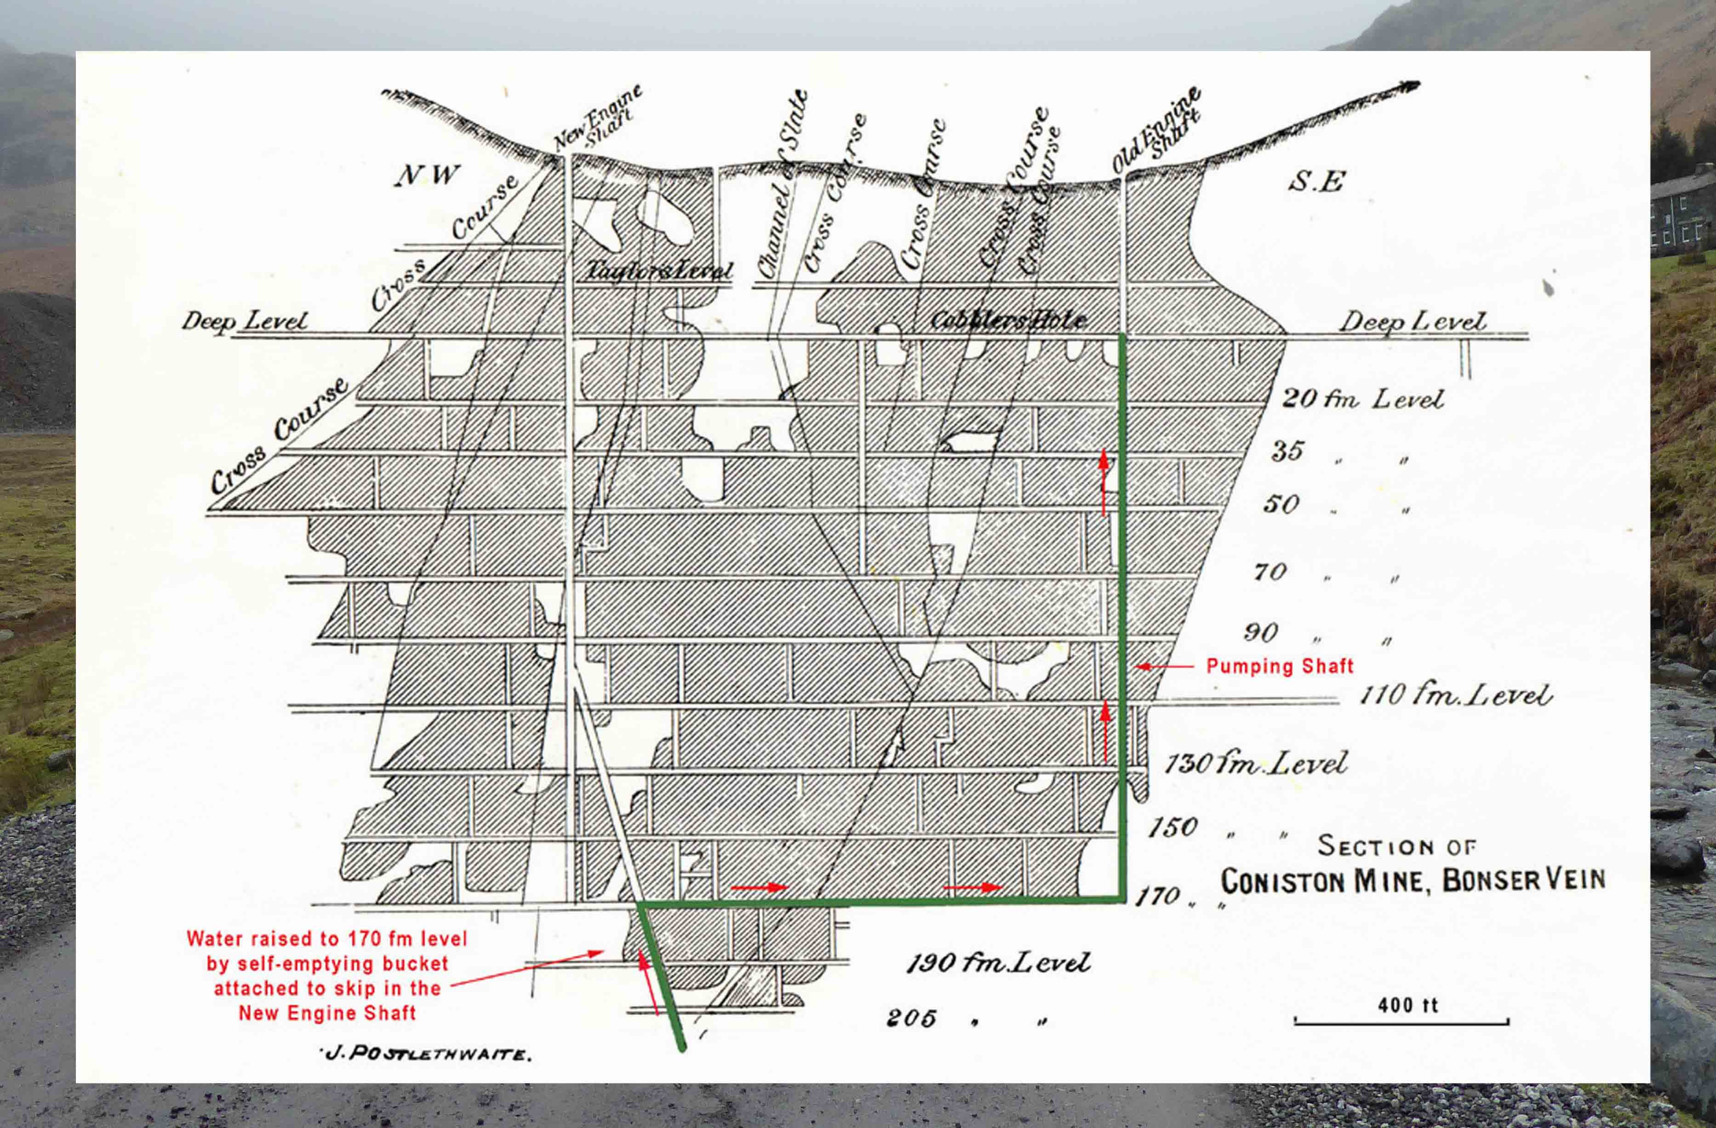
Timeline:
21st Century
Most of the mine is deep below the road - going down 1200 feet
There are parts of the mine above the road –going up 400 feet

Slide 10
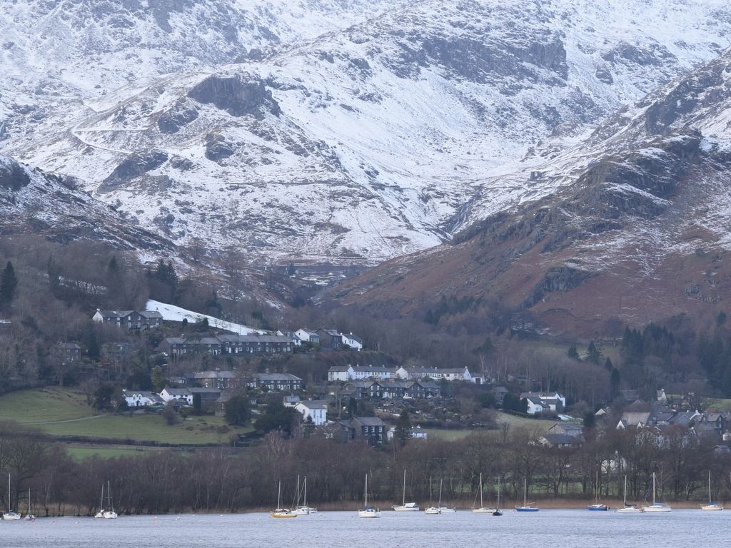
What would an opencast mine look like?

Slide 11
