Slide 1

Coniston Coppermines
Part 1
Stephe Cove October 2026
The first miners
Introducing copper
Processing the ores

Slide 2
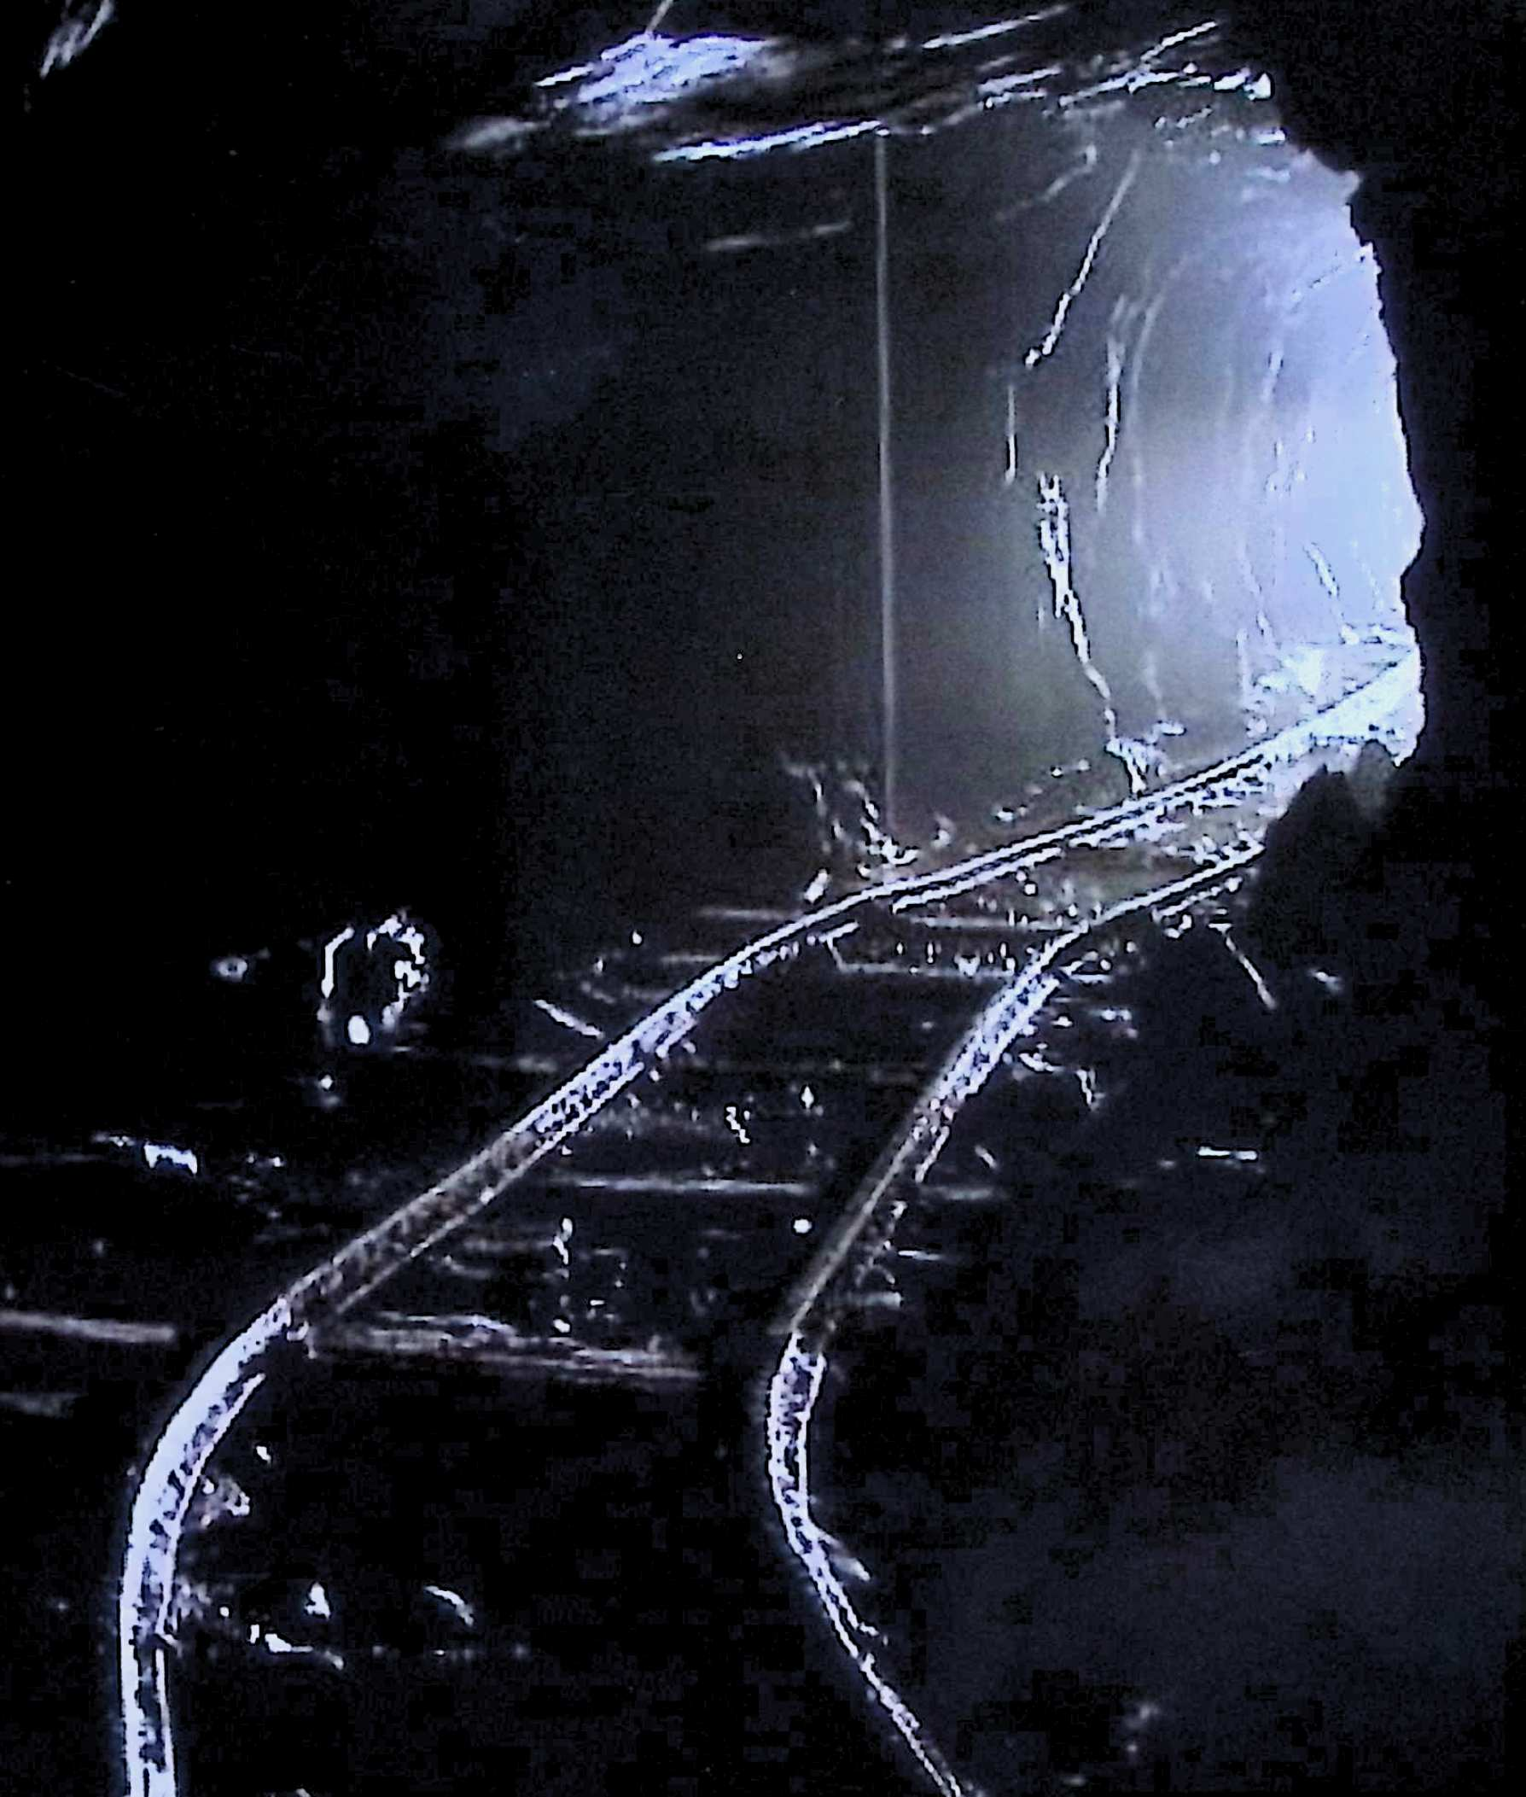
Coniston
Coppermines
For The
Ruskin Museum
October 2026
Stephe Cove

Slide 3
THE FIRST MINERS

Slide 4
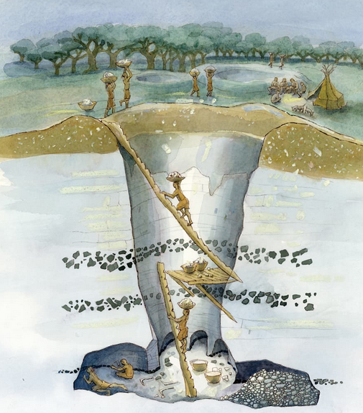
Mining Flints, Grimes Graves, Thetford - carrying
Timeline: 2600BC

Slide 5
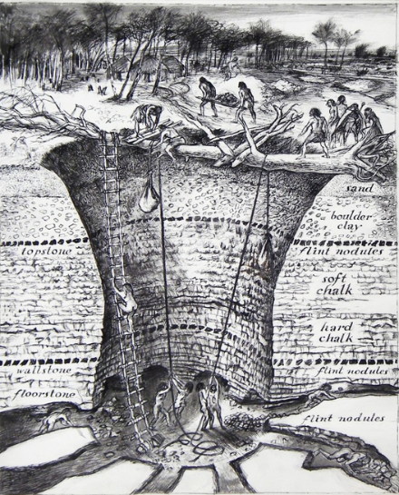
Grimes Graves, Thetford - lifting
OUT OF THE GROUND

Slide 6
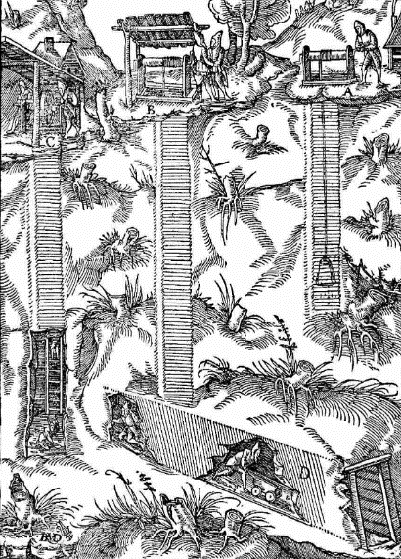
Jack roll - going deeper; lifting heavier loads
Timeline: 1400

Slide 7
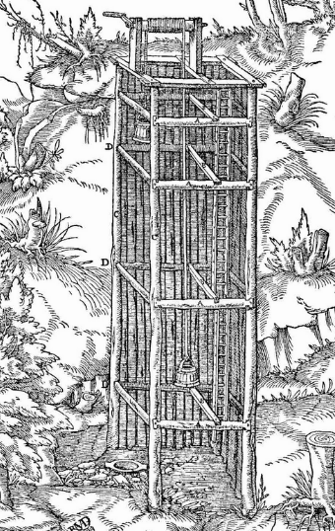
A kibble at surface, another at shaft bottom

Slide 8
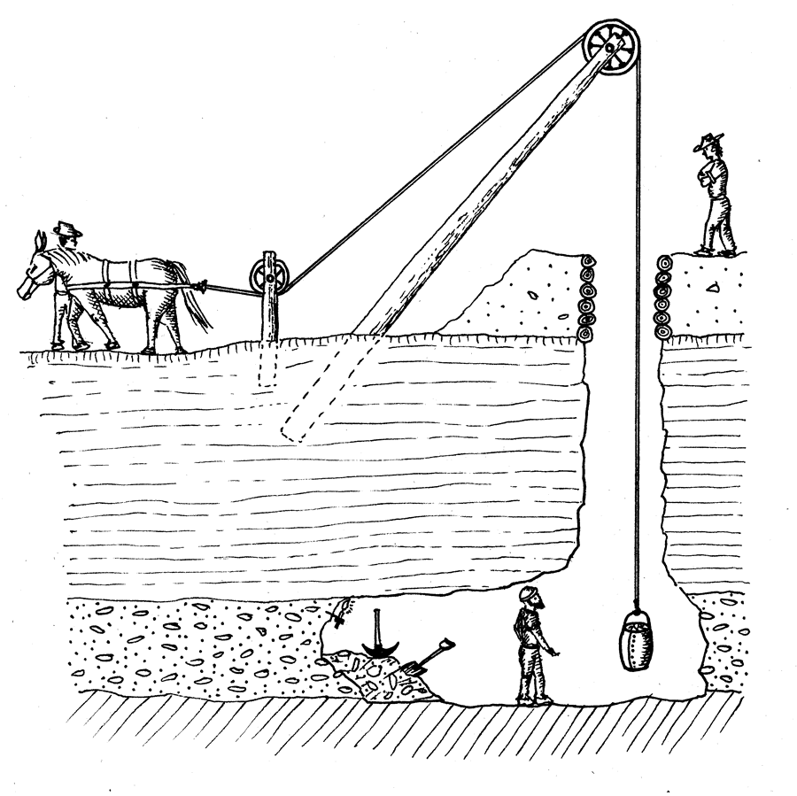
Direct horse power
Timeline: 1600

Slide 9
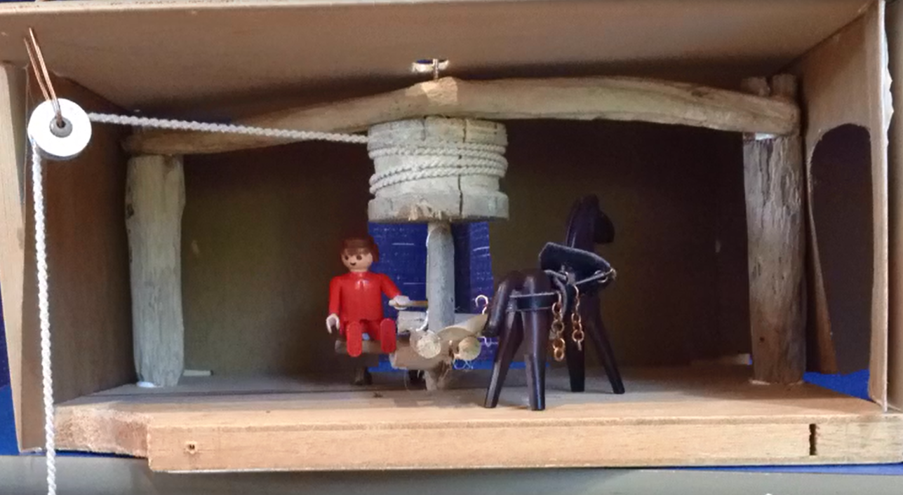
Horse gin winding kibbles up the shaft
OUT OF THE GROUND
Timeline: 2600BC

Slide 10
INTRODUCING COPPER

Slide 11
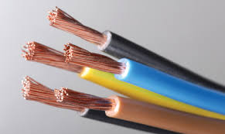
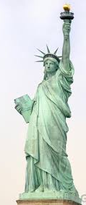
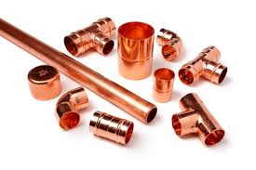
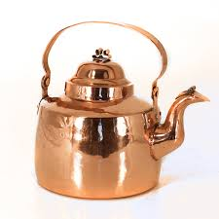
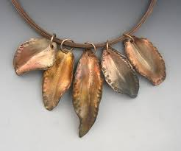
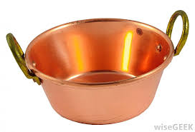
Copper is a metal

Slide 12
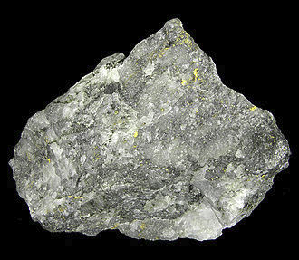
Metals come from ores
Rock containing gold is an Ore

Slide 13
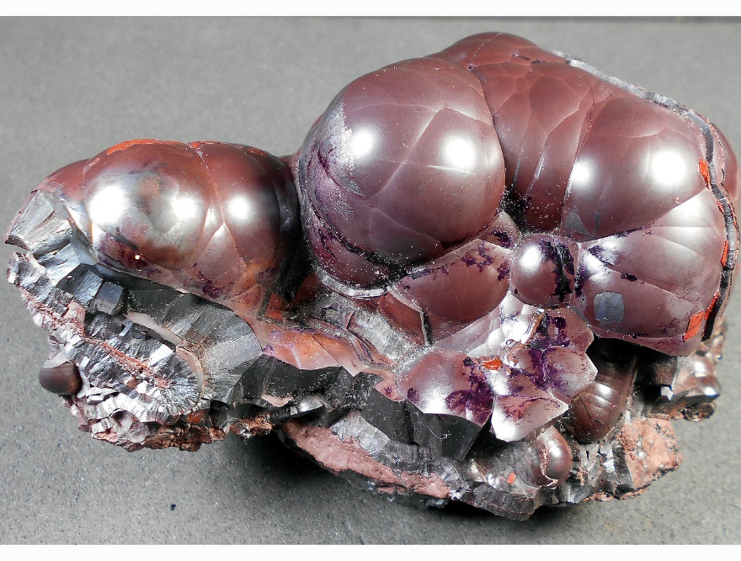
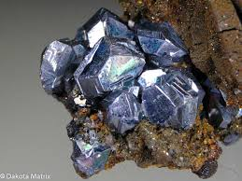
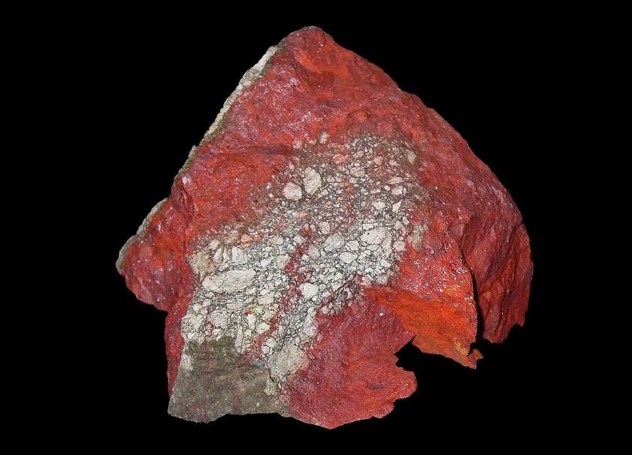
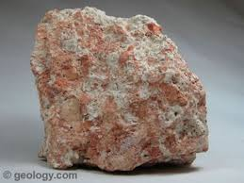
Ores are rocks mixed with metals
Galena -
Lead Ore
Haematite -
Iron Ore
Bauxite
Aluminium ore
Cinnabar -
Mercury Ore

Slide 14
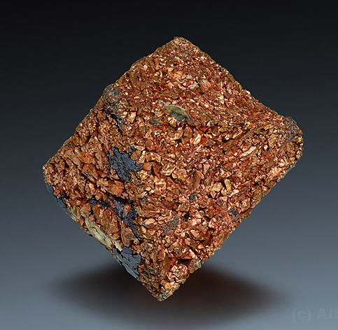
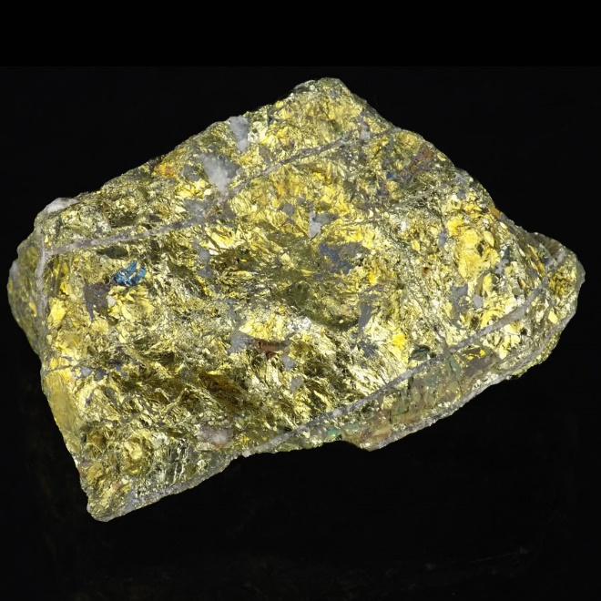
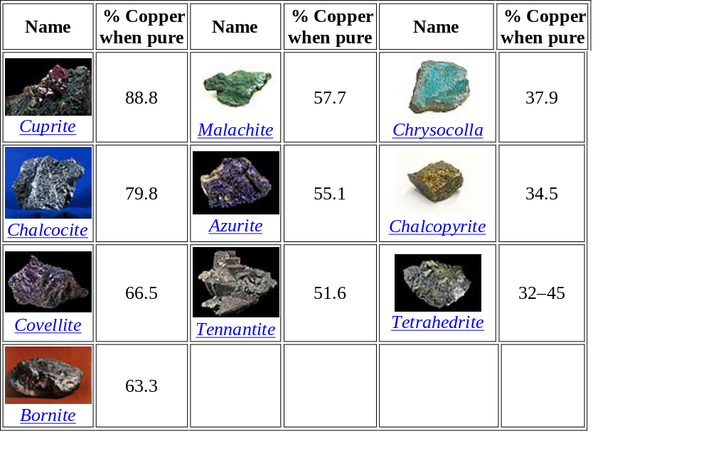
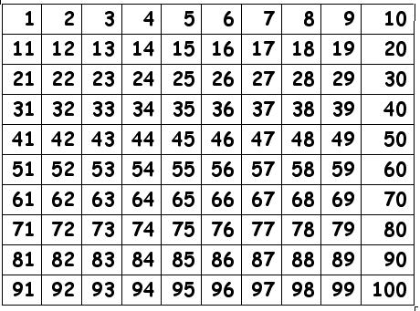
There are many different copper ores
Cuprite
Chalcopyrite
Cuprite
Chalcopyrite

Slide 15
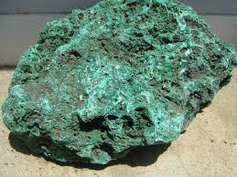
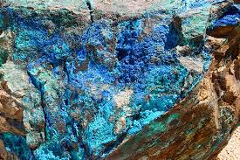
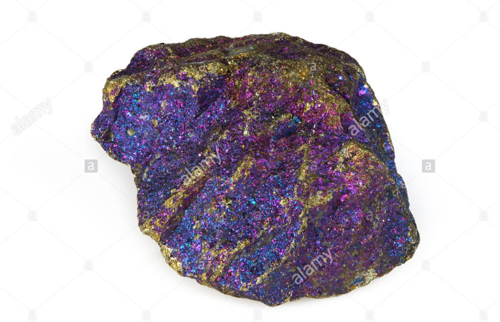
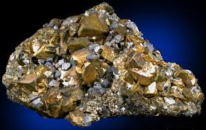
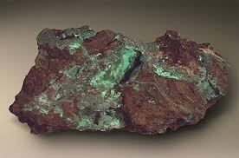
I like peacock ore (Bornite) best

Slide 16
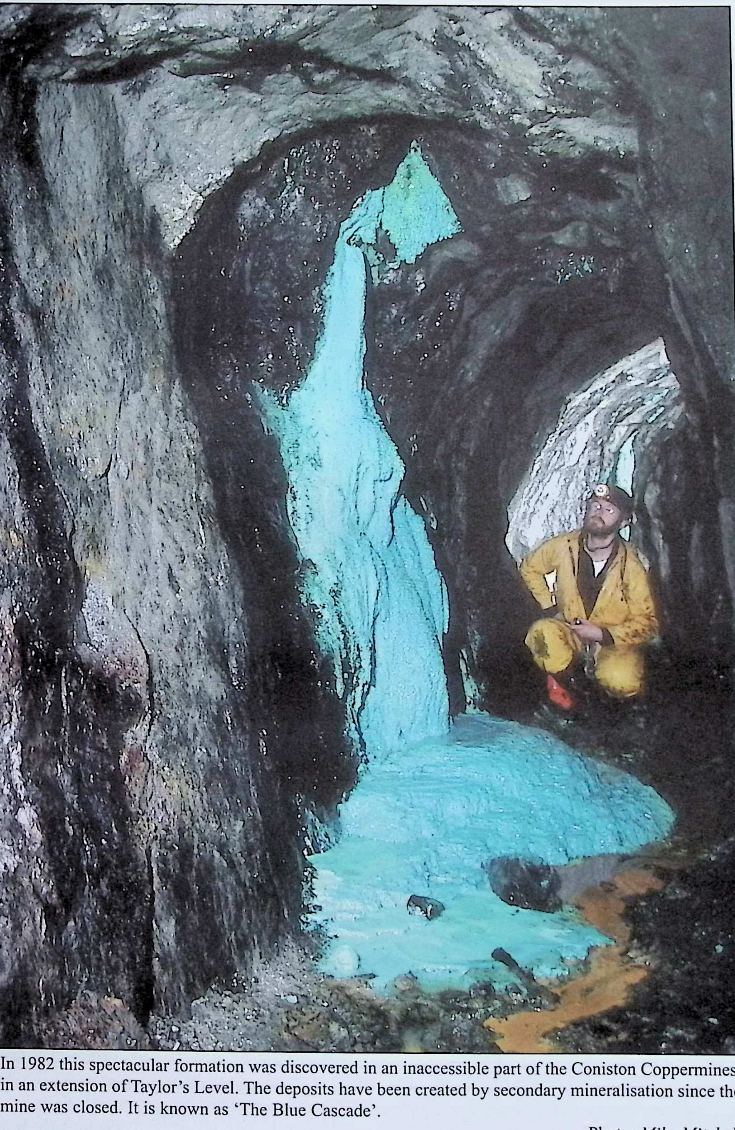
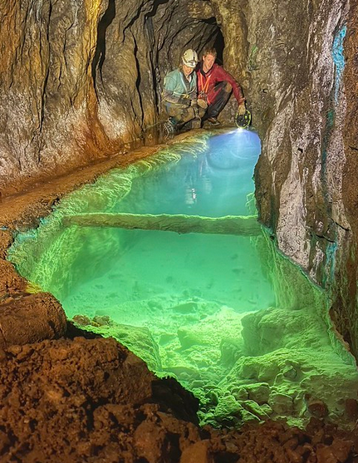
Secondary mineralisation

Slide 17
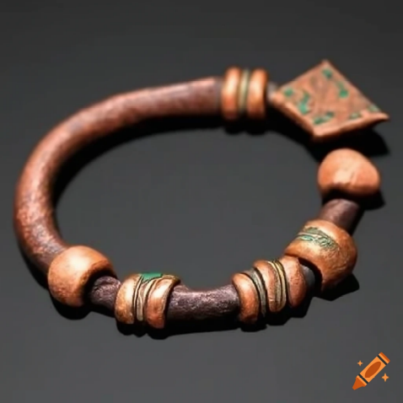
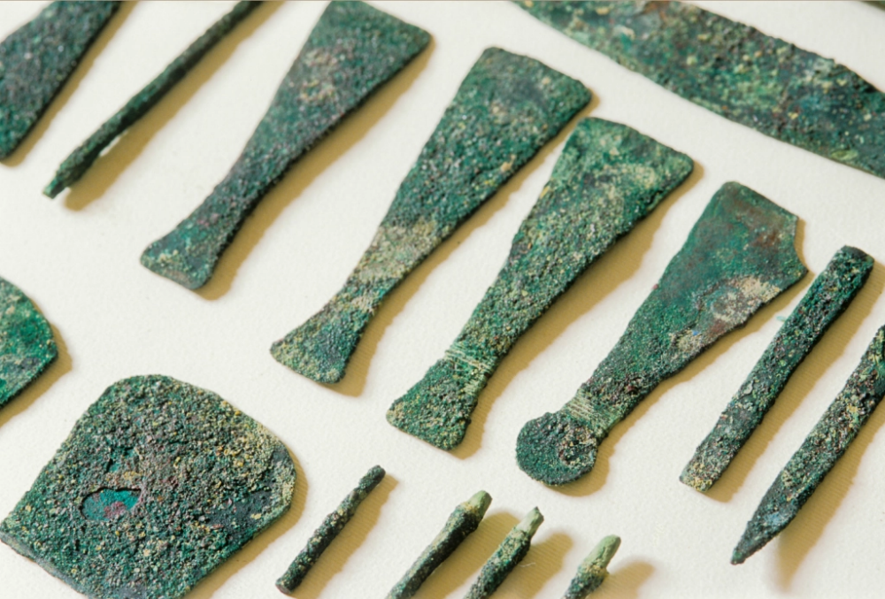
Copper – man’s oldest metal
Copper dates back more than 10,000 years. A copper pendant discovered in what is now northern Iraq has been dated to about 8,700 B.C.
The Egyptians used the ankh symbol to denote copper in their system of hieroglyphs. Copper also represented eternal life in their culture. The pyramids were built using copper tools

Slide 18
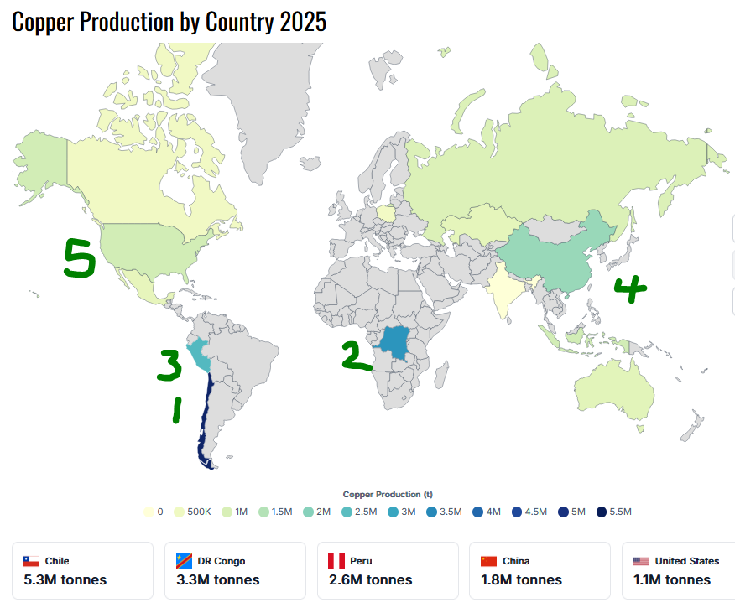
Chile, Democratic Republic of Congo and Peru are the world’s leading producers

Slide 19
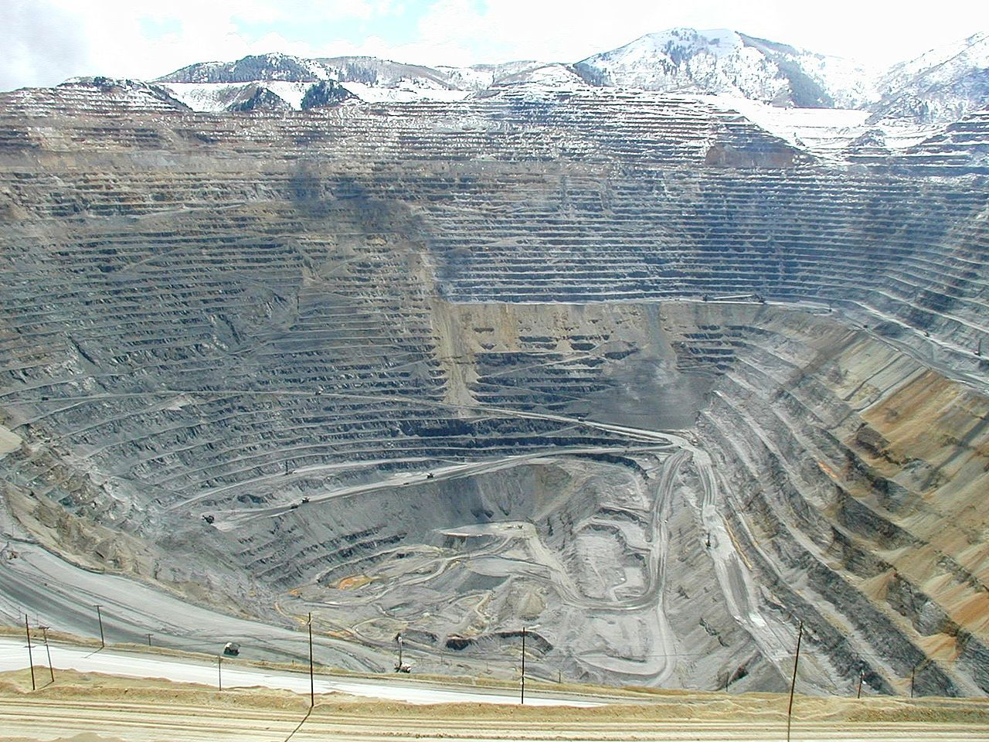
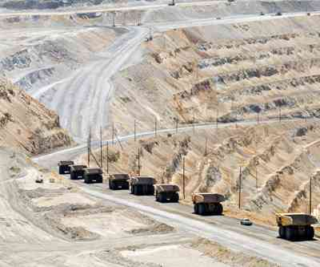
Open cast mining on a huge scale

Slide 20
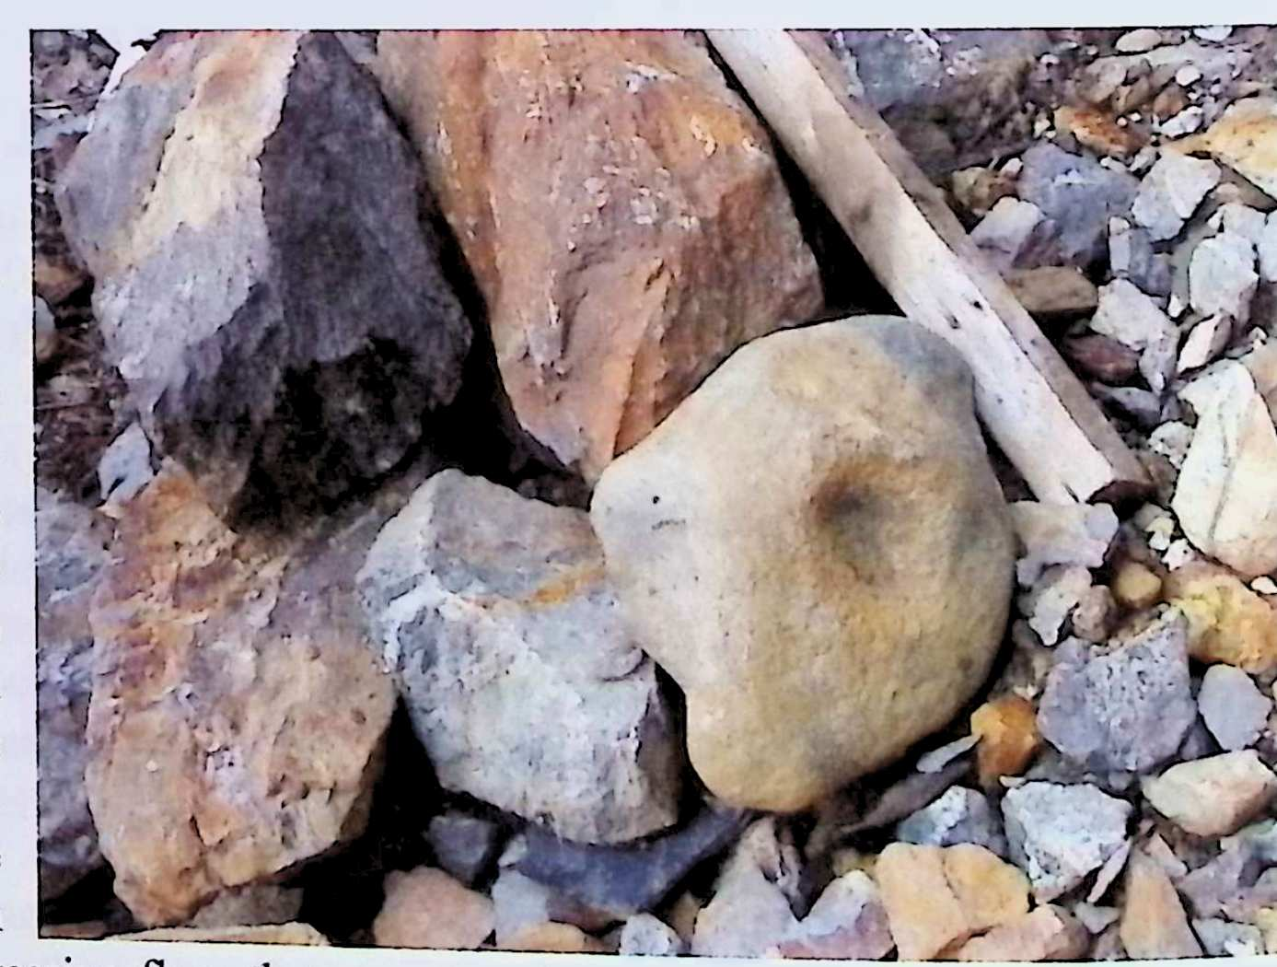
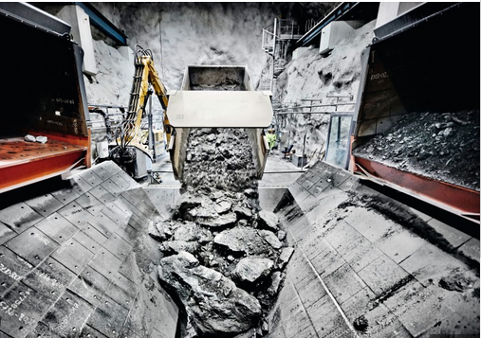
PROCESSING THE ORES

Slide 21
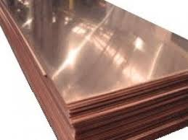
The copper needs to be separated from the rock

Slide 22
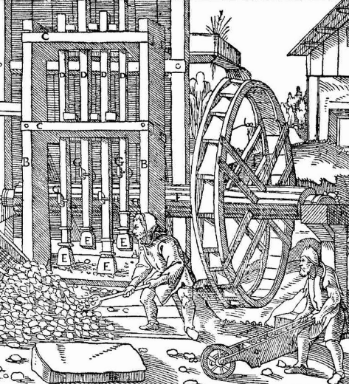
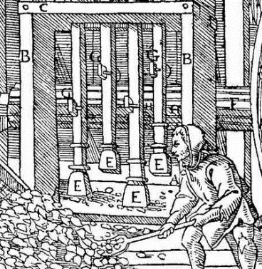
Water driven stamp mill – 4 stamps labelled “E”
Timeline: 1500

Slide 23
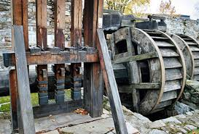
Timeline: 1850
Water driven stamp mill

Slide 24
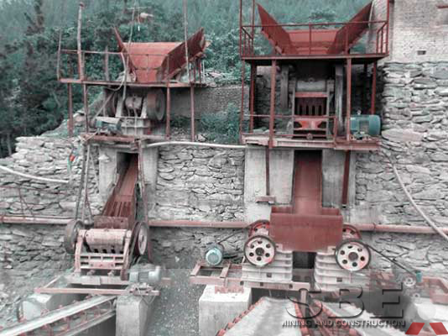
Electric powered crushing plant
Timeline: 1900s

Slide 25
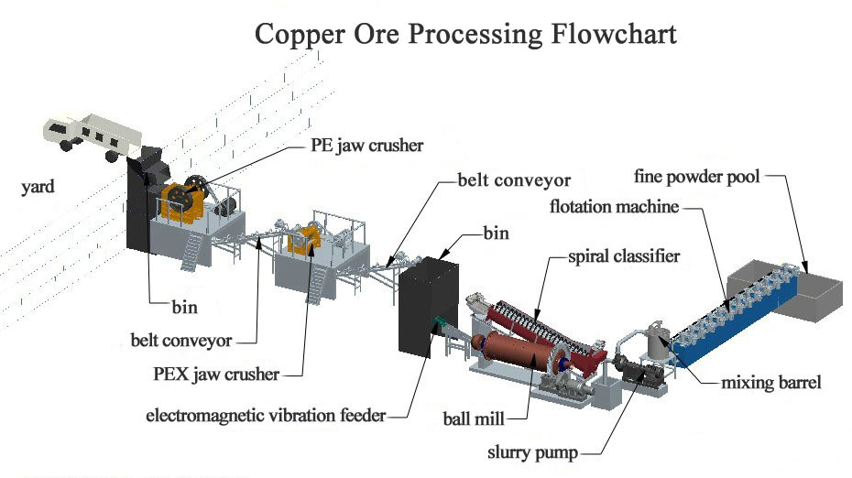
The modern separation process
Timeline:
21st Century

Slide 26
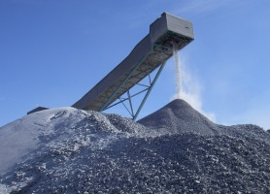
The powder is stored before processing
Timeline:
21st Century

Slide 27
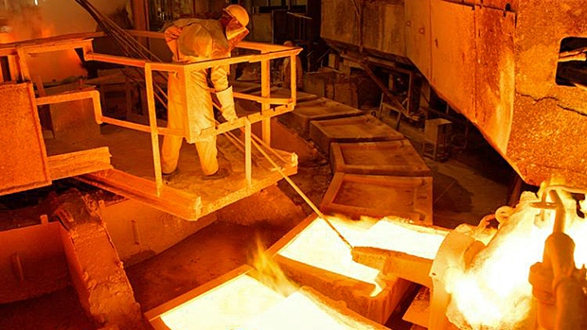
The powder is treated to get rid of the rock
- by heat

Slide 28
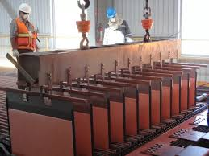
The powder is treated to get rid of the rock
- by electricity

Slide 29
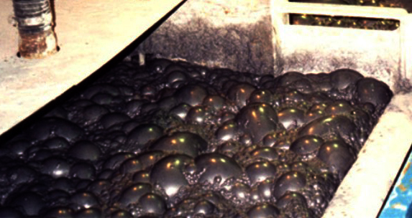
The powder is treated to get rid of the rock
- by floating the copper on bubbles

